Slide 1
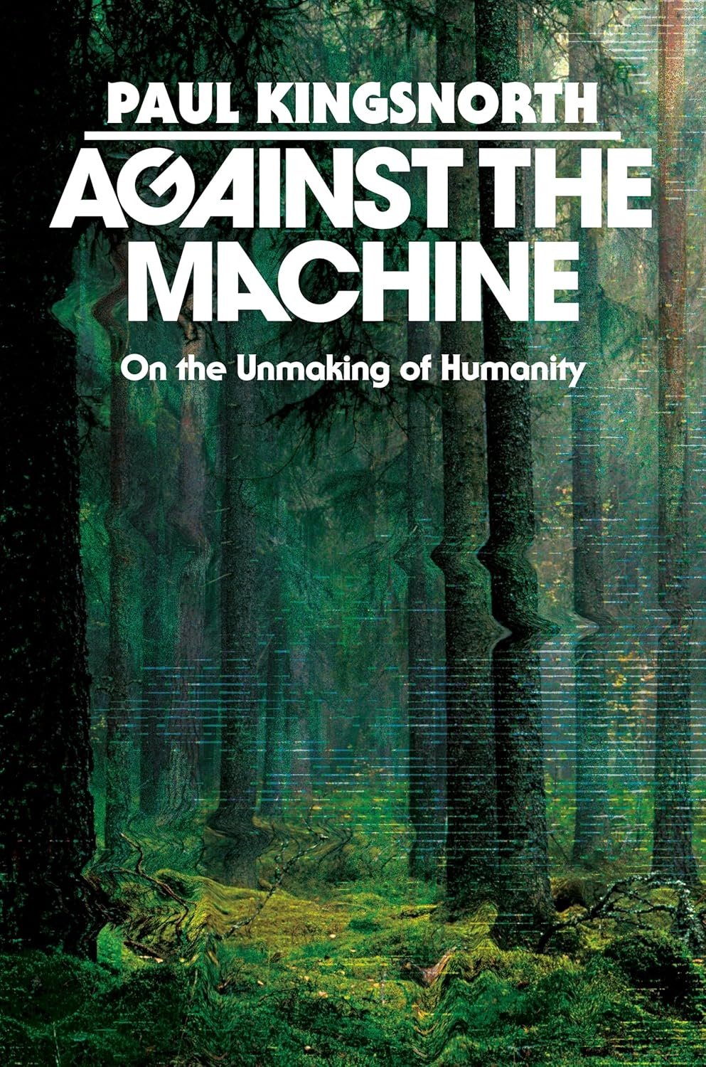
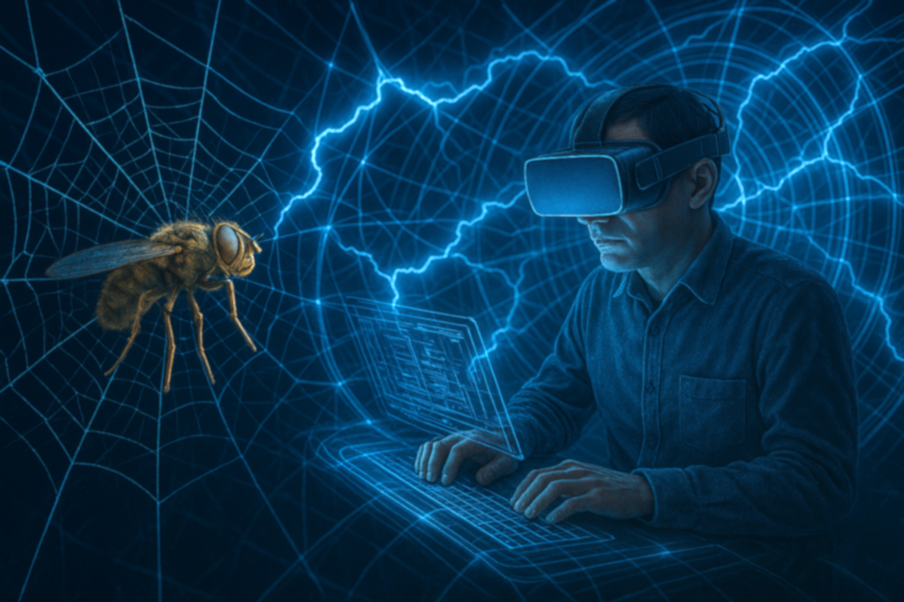

THESIS
K
Intuitive sense that we are living inside a system that isn’t human and that is tightening around us
(like a fish caught in a net or an insect in a web)
We know what technology gives us,
but what does it take away?
A study of the eclipse of humanity by man’s own technology

Slide 2
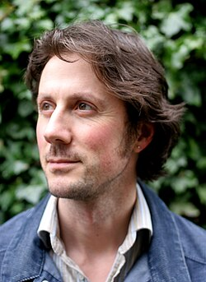
Bio --
K
St Agnes College, Oxford – History
Environmentalist; Journalist (deputy editor of The Ecologist Magazine).
Author of ten books of fiction, non-fiction and poetry.
A former practitioner of Zen, Daoism, mythology, Wikan, 2021 baptism into the Eastern Orthodox
Self-described as a conservative hippy, an Orthodox Christian anarchist, or a reactionary radical
Paul Kingsnorth
2001 - Named one of Britain's top 10 troublemakers (New Statesman)
2020 - Called "England's greatest living writer" (Aris Roussinous)
Advocate For --
A healthy suspicion of entrenched power, (leaders, states, corporations)
Decentralization of economics, politics and culture
Connection to land, nature and heritage
Deep attention to matters of the spirit
Freedom of expression and an appreciation of beauty

Slide 3
Uprooted in the West
A
"The point to focus on is this: that when a culture built around such a sacred order dies then there will be upheaval at every level of society, from the level of politics right down to the level of the soul."
"Cultures are built around claims and beliefs about the otherworld: about God or gods, about correct worship, about the nature of reality, about goodness and truth and the meaning of virtue. These are also, inevitably, claims about what it means to be human. Knock out the spiritual core of any culture, and however hard people fight, its fate is sealed."

Slide 4
Unmasking Humanity
A
Values (4 Ps)
Rejection of...
Past: Where a culture comes from, its history and ancestry
People: Who a culture is; sense of being 'a people'
Place: Where a culture is. Nature in its local and particular manifestation
Prayer: Where a culture is going. Its religious tradition, which relates it to God or the gods
Past: Uprooting origins and sacred tradition through Modernity
People: Humans replaced by technology
Place: Commercial invasion of natural communities
Prayer: Ideologies that rob people of purpose and meaning and nullifies a transcendent being

Slide 5
Decline of the West
A
Crumbling into decadence and disintegration
“… is not a matter of the wrong people being in charge, or the wrong economic policies… not due to the rise of China or Russia, or racism, or misinformation, or nasty populists, or the institutionalization of ‘woke’ ideology. It will not be solved by tougher border controls , or radical rightist governments or revolutions, or
decolonization, or controls on freedom of speech in the name of protecting our democracy.
Any number of these things might be real or true or desirable, but they are symptoms, not causes of our malaise. The malaise is deeper, older and more interesting and far more consequential… effects the very basis of our humanity” (xix)

Slide 6
Decline of the West
A
Crumbling into decadence and disintegration
“We find ourselves rootless, rudderless, unmoored in a great sea of chaos; angry, confused, shouting at the world and each other” (18)
Condemnation of Christianity (replace with other religions)
Condemnation of the past (revisionist history)
Rise of Social pathologies
Colonization from within
Deconstruction of family, community, and worship
Traditional religion is being replaced by a new religion

Slide 7
MACHINE IS A WAY OF SEEING
K
A perspective and a relationship we have with the world that makes us very good at categorizing and analyzing and creating tools to see and interact with the particulars/the parts.
Have we lost the perspective of seeing the whole?
Notes:
“when we moved from Christendom via the Enlightenment into our current age, we disenchanted our culture- we became pure materialists” (34)
Machine is a way of seeing – 1st is pharaonic pyramids . . . Slavery. Blackships entering Japan☹1853/ Mathew Perry.
Progress is powered by Greed. Development is Colonialism – puts country’s in debt, destroys domestic economies. Forces trade
Continuing the work of Fillmore/Perry then Truman with World Bank, IMF, WTO, -- rebuilding nations for the profits of world corporations…l Black ships are now black hawk helicopters.

Slide 8

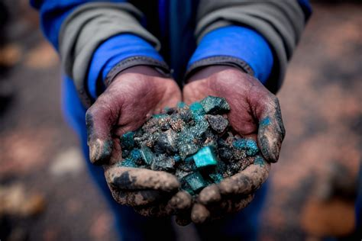

MACHINE IS A WAY OF SEEING
K
PROGRESS
DEVELOPMENT
TECHNOLOGY
Cobalt Mines
Highly mechanistic and commercial way of seeing that has created a new belief system, and its own value system
The belief in the notion of Progress as a “moving forward” (98)
The belief of Development as helping the “poorer” parts of the world (106)
Modern Day Slavery
Rebuilding nations for the profits of world corporations
Notes:
“when we moved from Christendom via the Enlightenment into our current age, we disenchanted our culture- we became pure materialists” (34)
Machine is a way of seeing – 1st is pharaonic pyramids . . . Slavery. Blackships entering Japan☹1853/ Mathew Perry.
Progress is powered by Greed. Development is Colonialism – puts country’s in debt, destroys domestic economies. Forces trade
Continuing the work of Fillmore/Perry then Truman with World Bank, IMF, WTO, -- rebuilding nations for the profits of world corporations…l Black ships are now black hawk helicopters.

Slide 9

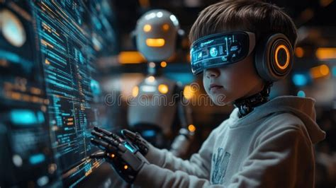
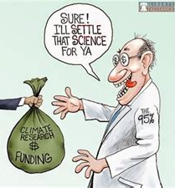
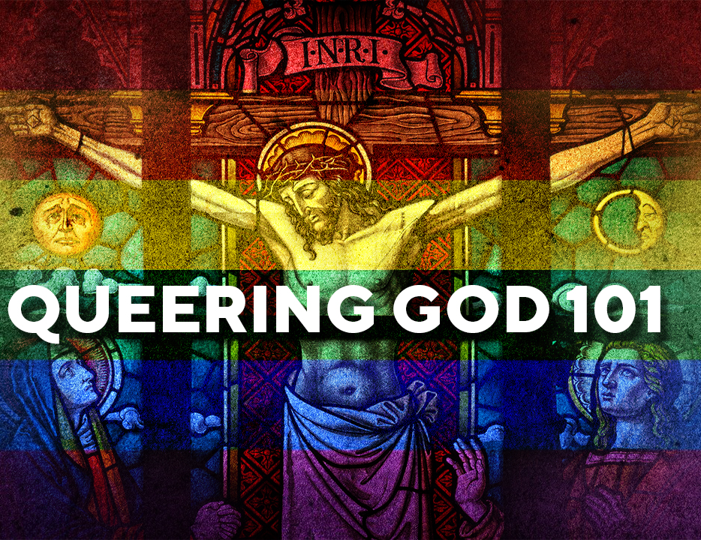
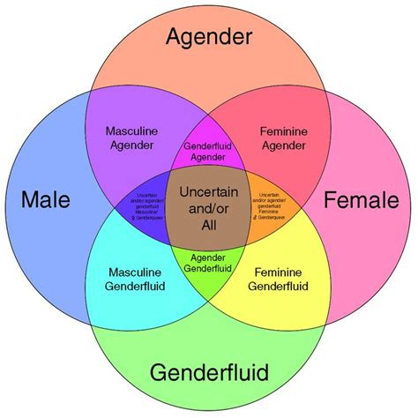
MACHINE IS A WAY OF SEEING
K
THE 4’s
SELF
Who we are. The highest good is to serve the self and ensure longevity
SCREEN
Where we are going. Both our distraction and the means of coming to the Machine
SEX
What we do. Highest means of pleasure and affirmation of individual identity
SCIENCE
Where we come from. A non-mythic that claims truth based on measurement and tools
Screen: Where we are going. Both our distraction and the means of coming to the Machine.
Notes:
The end game is transhumanism. Self-creation thru transhumanism. Us as God. Sexual expression as the core of our being and identity. “Pride” month –pseudo religious festival
Worship self, Science is the religion, Sex is the prayer,

Slide 10
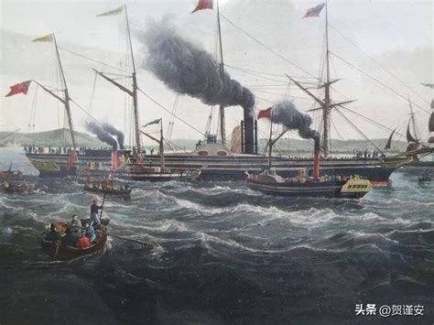
MACHINE IS A WAY OF SEEING
K
Feudal Japan Hierarchy
Emperor
Military Leader (shogun)
Aristocrats (daimyo)
Military Samurai
Peasants/farmers
Artisans/makers
Merchants
Building a global trading system, 1853
America/West
Merchants
Aristocrats/Govt
Military
Artisans
Farmers/Deplorables
Notes:
“when we moved from Christendom via the Enlightenment into our current age, we disenchanted our culture- we became pure materialists” (34)
Machine is a way of seeing – 1st is pharaonic pyramids . . . Slavery. Blackships entering Japan☹1853/ Mathew Perry.
Progress is powered by Greed. Development is Colonialism – puts country’s in debt, destroys domestic economies. Forces trade
Continuing the work of Fillmore/Perry thenTruman with World Bank, IMF, WTO, -- rebuilding nations for the profits of world corporations…l Black ships are now black hawk helicopters.

Slide 11

MACHINE IS A WAY OF SEEING
K
Seven deadly Sins is what drives the machine onward: gluttony, lust, pride, wrath, greed, (sloth), envy
Today (2020s) – The West is being structurally adjusted. We are Colonizing ourselves in service of the MACHINE’s value system (107)
Globalism – “Openness” (open borders, open doors, open hearts, open to trade, open to growth (It benefits the larger project)
Any desire/value to be “closed” (Japan, Brexit, Trump) is bad – “closed things can’t be exploited, harvested, transformed in the image of the new world that the MACHINE is building.” (108)
Notes:
Widening social classes, deplorables, societal instability

Slide 12
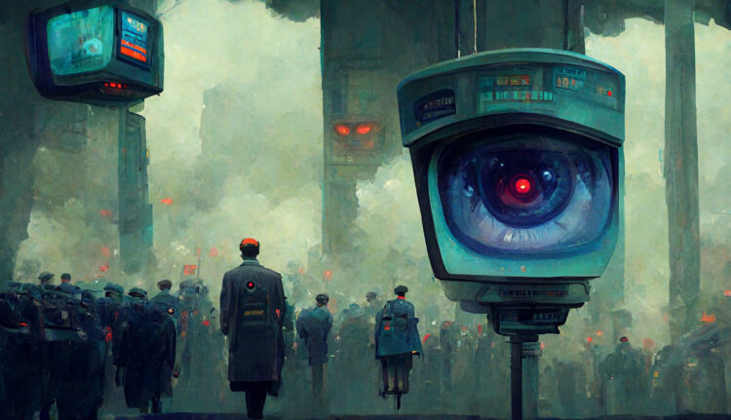
K
The Myth of the Machine (Lewis Mumford, 1967)
“Throughout recent history, voices of dissent have risen against the encroaching dominion of the MACHINE. Philosophers, writers, and filmmakers have sounded the alarm. Yet, the MACHINE endures, its resilience rooted in its ability to absorb criticism, co-opt dissent, and commercialize resistance. Movements once perceived as counter-culture (environmentalism, feminism) have fallen prey to its assimilative power, mutating into advocates for agendas that unwittingly advance its cause.” (https://spotterup.com/unveiling-the-myth-of-the-machine/
Notes:
https://spotterup.com/unveiling-the-myth-of-the-machine/
https://archive.org/stream/in.ernet.dli.2015.214098/2015.214098.The-Myth_djvu.txt

Slide 13
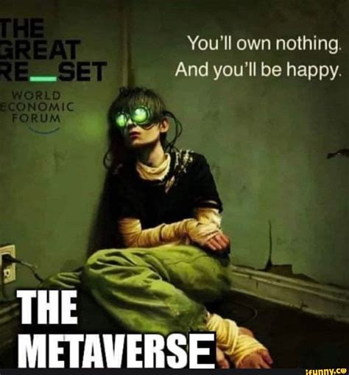
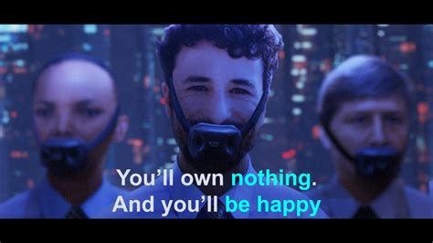

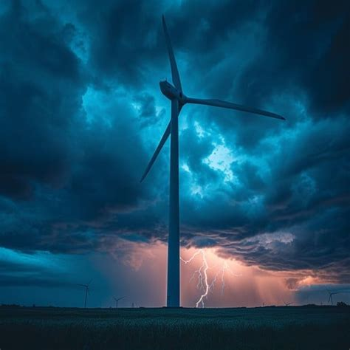
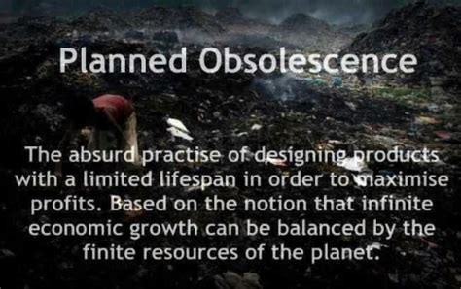
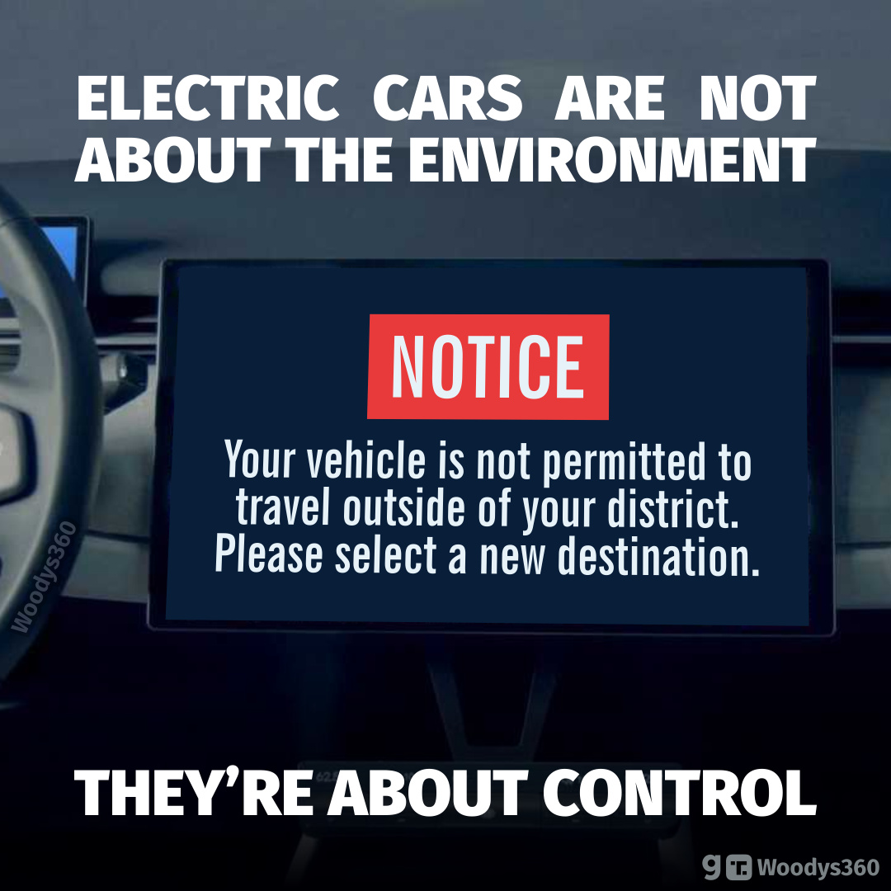
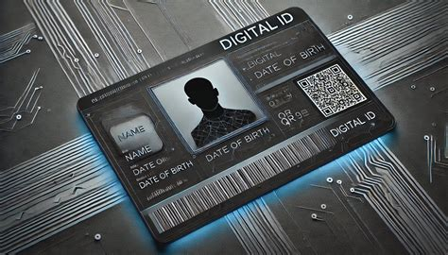

K
A 2-megawatt windmill is comprised of 260 tons of steel made from 300 tons of iron, 170 tons of coal, all mined, transported, produced by hydrocarbons – then it kills 1 million birds annually, and in 17 years -- it falls apart.
Notes:
the United States is projected to have about one-fifth of the world’s blade waste of over 47 million tons by 2050.
Wind turbines kill over 1 million birds a year. Wind energy, will receive an estimated $425 billion in subsidies between 2023 and 2033 in addition to about $200 billion in other green energy subsidies.

Slide 14



K
Are we living in a world where Agent Smith is the hero and Neo is a conspiracy theorist?
“If you have to be persuaded, reminded, pressured, lied to, incentivized, coerced, bullied, socially shamed, guilt-tripped, threatened, punished and criminalized: If all this is considered necessary to gain your compliance -- you can be absolutely certain that what is being promoted is not in your best interest.” – Ian Watson, science fiction writer.
Notes:
Ian Watson – Sci-fi writer

Slide 15
K-A
“Our Stories are cracked at their foundations, and as a consequence we are afloat in a fantastical world of our own making: grasping at freedom, entirely enslaved”

Slide 16
. . . The machine appeared In the distance, singing to itself Of money. Its song was the web They were caught in, men and women Together. The villages were as flies To be sucked empty. God secreted A tear. Enough, enough, He commanded, but the machine Looked at him and went on singing.
– “Other” by Welsh poet, R.S. Thomas

Slide 17
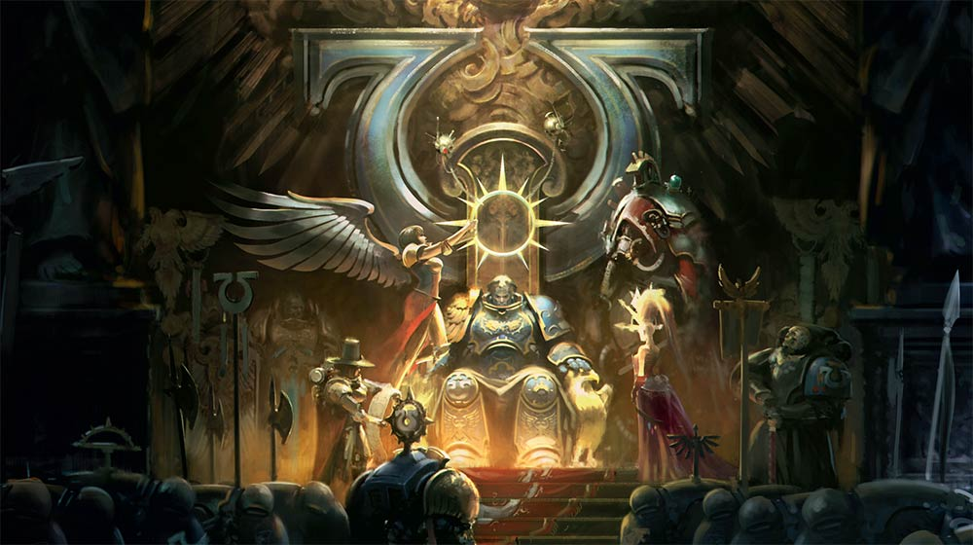
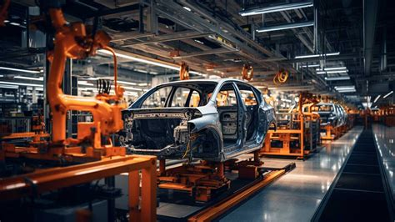
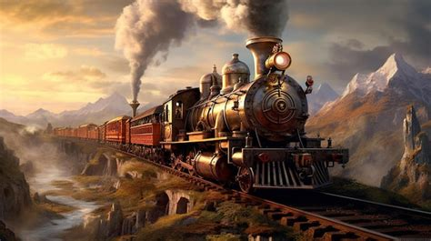
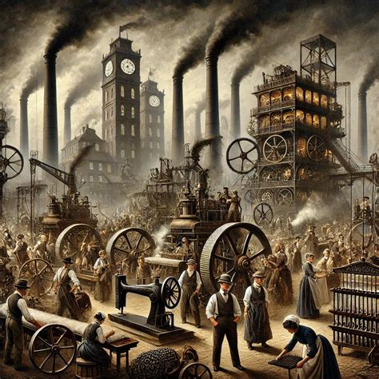
There is a throne at the heart of every culture and whoever sits on it will be the force you take your instruction from. When a culture kills its sovereign, the throne will not remain empty for long.
A
The Machine manifests today as an intersection of money power, state power, and coercive and manipulative technologies – in an ongoing war against roots and limits!
Notes:
“when we moved from Christendom via the Enlightenment into our current age, we disenchanted our culture- we became pure materialists” (34)
Machine is a way of seeing – 1st is pharaonic pyramids . . . Slavery.
Modernity’s way of seeing -- highly mechanistic, creating a new belief system. We believe in the notion of progress as a moving forward

Slide 18

“Imagine that some being of pure materiality, some being opposed to the good, some ice cold intelligence from and ice cold realm, were trying to manifest itself here. How would it appear? Not surely as clumsy, messy flesh. Better to inhabit, to become, a network of wires and cobalt, of billions of tiny silicone brains, each connected to a human brain, whose energy and power and information and impulses and thoughts and feelings could all be harvested, to form the substrate of an entirely new being.”
A
Are we in a ”war” with an enemy that doesn’t look like us – spiritual? alien/technological?
Notes:
Karen asked AI to create an Image based on the description. Are we in a ”war” with an enemy that doesn’t look like us – spiritual, alien/technological?

Slide 19
Recovering What Matters
A
Be Rooted – Realize it’s spiritual warfare
Basic failure of the dream is the world is not rational and neither are we (110)
Guarding the heart (99)
20th century man has been called upon to discover truth. . .Where “want” had been the apriori value, it’s now turning to “truth”
Guidance cannot be found in science or technology. You need to put your own house in order based on the traditional wisdom of mankind
Need to be adults, grow-up. Rebuild families and communities
Heal through story and ritual: myth work; multi-generational work. “We don’t know where to begin”
Notes:
“Our Stories are cracked at their foundations, and as a consequence we are afloat in. a fantastical world of our own making: grasping at freedom, entirely enslaved -- WEF: You will own nothing and be happy!!

Slide 20

What aspect of Kingsnorth’s position do you find the most intriguing or emotionally effecting?
Do you agree with Kingsnorth’s interpretation of THE MACHINE? Do you think The Machine’s way of seeing and being in the world explains many of the problems we face? Is technology impacting humanity?
What limits should be placed on private actors who control infrastructure (data platforms, energy grids, biotech)? What tools, laws, oversight, decentralization are realistic?.
Are we in a ”war” with an enemy that doesn’t look like us – spiritual? alien/technological? Are we living in a world where Agent Smith is the hero and Neo is a conspiracy theorist?
Which institutions (governments, corporations, foundations, universities) most urgently need accountability for harms that have been done to “our culture”? How can the harms be corrected?
How can citizens and communities exercise meaningful influence over technical decisions that shape their lives?
Notes:
Suggested questions – please add or change!

Slide 22
The Myth of the Machine (Lewis Mumford, 1967)
Communism and Fascism, purported alternatives to Liberal Capitalism, are variants of the same MACHINE-driven ideology
Under the guise of creating Utopian societies, they all have the traits of Control, Materialism, Militarism, Totalitarianism, Lysenkoism, Eugenics
The workings of the MACHINE reverberate through every facet of society: institutions, ideologies, subconscious; even movements like social justice, environmental stewardship, green movement – no longer simple, back to nature but champion agendas that industrialize food supply and prioritize technological solutions.
Notes:
Lysenkoism --
https://archive.org/stream/in.ernet.dli.2015.214098/2015.214098.The-Myth_djvu.txt

Slide 23
The Myth of the Machine (Lewis Mumford, 1967)
Traits of MACHINE – centralized, hierarchial society governed by effective bureaucracies and enforced by military and police.
Its economy, directed by financial institutions, thrives on expansion thru colonization and technological integration
Propaganda normalizes it’s agenda, perpetuates narratives of progress, openness and individualism while suppressing dissent and alternative perspectives.
Feminism – fuels the MACHINE by advocating for erasure of traditional family structure in favor of workforce of woman
Woke Capitalism – masquerades as social justice, yet aligns with MACHINE’s values by co-opting activism for profit while silencing dissent through censorship and corporate hegemony
Notes:
https://spotterup.com/unveiling-the-myth-of-the-machine/
https://archive.org/stream/in.ernet.dli.2015.214098/2015.214098.The-Myth_djvu.txt

Slide 24
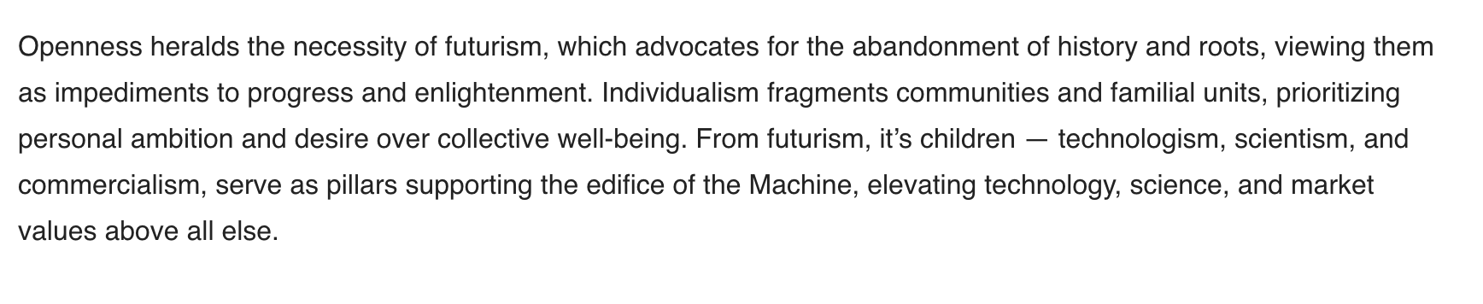
The Myth of the Machine (Lewis Mumford, 1967)
Notes:
https://spotterup.com/unveiling-the-myth-of-the-machine/
https://archive.org/stream/in.ernet.dli.2015.214098/2015.214098.The-Myth_djvu.txt

