Slide 1
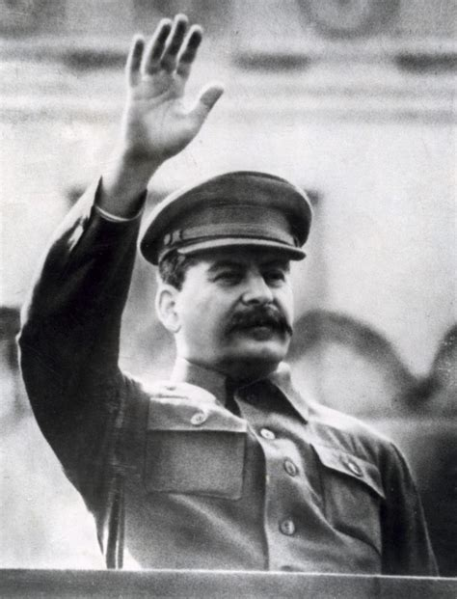
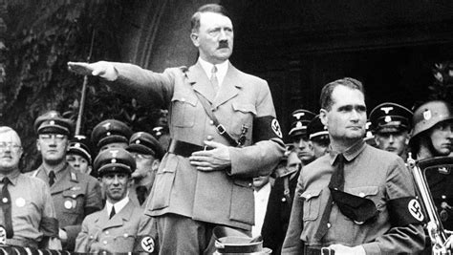
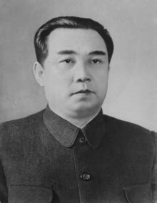
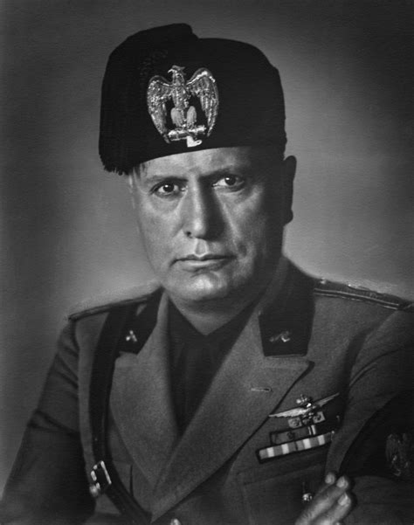
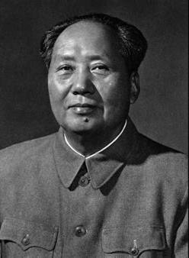

The Psychology of Totalitarianism
By Mattias Desmet

Slide 2
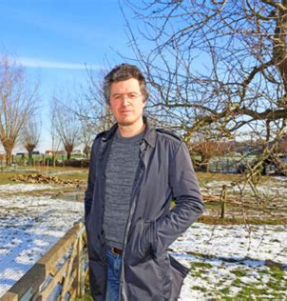
--a Belgian clinical psychologist and professor in clinical psychology at Ghent University. He has a doctor of philosophy in psychological sciences and a master's degree in statistics.
Dissertation on the validity of instruments used in psychological research.
Author of several books and over 50 articles.
MATTIAS DESMET

Slide 3
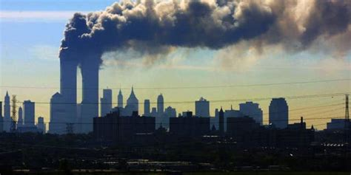
WHY DESMET WRoTE THE BOOK
The bigger a state grows, the greater the need for a massive administrative apparatus to operate its many functions. This isn’t mundane paper-pushing bureaucracy. It’s a sinister and smothering onset of Tyranny
Erosion of Right to Privacy
Grip of Govt on private life
Climate fear and ”Woke” culture created hyper-strict govt and growth of bureaucratic powers from the population itself
Tracking and tracing acceptable
Notes:
With his background in statistics, Desmet studied the statistics that were presented by government and media outlets, noting that most of the people uncritically accepted these numbers, even though they were often "blatantly wrong", he started to study this phenomenon from a mass psychology perspective.

Slide 4



CORONA VIRUS (2019)
The Perfect Storm to enable Mass Formation and bring about Totalitarianism
Why would people accept mitigation measures issued by governments without question, and then denounce those who were critical of such measures, or who questioned the severity or even the origin of the virus?
Notes:
With his background in statistics, Desmet studied the statistics that were presented by government and media outlets, noting that most of the people uncritically accepted these numbers, even though they were often "blatantly wrong", he started to study this phenomenon from a mass psychology perspective.

Slide 5
OVERARCHING Themes
Mechanistic science fosters alienation and loss of meaning.
Mass formation, a precursor to the rise of Totalitarianism, thrives when a people are anxious, isolated, and without purpose.
Totalitarianism flourishes when narratives suppress dissent, truth is subjective, and the individual is powerless.
Violence tends to be perpetrated by those who lack power, and the modern nation-state (thru its institutions and bureaucracy) makes people feel powerless leading to frustration and aggression - Perhaps a reason for school shootings (modern society’s most draconian of institutions in which the individual and family has the least power).
Path forward: enable a rebirth of truth-telling, restore meaning, teach and act with humility and moral responsibility, restore individual freedoms and control.

Slide 6
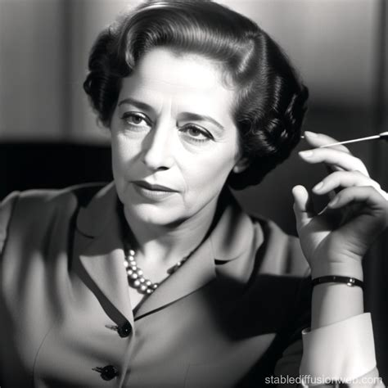
Moving Towards Totalitarianism
“The ideal subject of totalitarian rule is not the convinced Nazi or the dedicated communist, but people for whom the distinction between fact and fiction, true and false, no longer exists.”
-- Hannah Arendt
The aim of totalitarian education has never been to instill convictions but to destroy the capacity to form any.
One of the greatest advantages of the totalitarian elites of the twenties and thirties was to turn any statement of fact into a question of motive.
Under conditions of tyranny it is far easier to act than to think.
The greater the bureaucratization of public life, the greater will be the attraction of violence.

Slide 7
From Book to Conversation
Part One: Science and Its Psychological Effect
FIC Discussion
Part Two: Mass Formation and Totalitarianism
FIC Discussion
Part Three: Beyond the Mechanistic Worldview
FIC Discussion

Slide 8
Part I – INTRO Science and Its Psychological Effect
Enlightenment began with good intentions but caused science to tip from open-mindedness to dogma and blind conviction.
The ideology of reason has been a persistent attempt to squeeze life into logic and theories, placing poetry, symbolism and mysticism secondary – but those are the ways of thinking necessary for responding to the uncertainty of life
The utopian pursuit of an artificial and controllable universe equates to the destruction of the essence of life
Belief in objectivity and measurability of the world leads to absurd arbitrariness, subjectivity, and the need for an authoritarian bureaucracy and master that provides direction to shoulder the burden of freedom.
A psychologically exhausted population -- fearful, socially atomized, void of purpose, without connection -- loses the right to their own life.
Those who don’t believe in mainstream narratives are stigmatized and destroyed.
Notes:
People believe the technology and technocrats should lead during a crisis..
Can’t reduce and categorize things around you. There’s a limit. When you’re logical, connect everything from dot to dot, you have a closed system, but life isn’t closed – it’s irrational.
-- Heisenberg uncertainty principle – ”it’s impossible to determine facts – relinquish the illusion that man can ever attain certainty…. All the great scientists finally came to the belief that truth cannot be discovered through measurement. …. The great minds who followed reason and facts concluded “the essence of things is beyond logic and cannot be grasped.”

Slide 9
Science and Ideology
2007, Johnny Ioannidis (Stanford) – most research studies are misleading, flawed, fraudulent, and contain bias
85% of published studies are flawed and can’t be duplicated
Heisenberg uncertainty principle – ”it’s impossible to determine facts – relinquish the illusion that man can ever attain certainty….
All the great scientists finally came to the belief that truth cannot be discovered through measurement. …. The great minds who followed reason and facts concluded “the essence of things is beyond logic and cannot be grasped.”
Rationality can’t be the fundamental basis of society. Its’ too limiting. We must re-discover the eternal, ethical principals of humanity.
Notes:
Johnny Ionnisdis ….. Professor at Stanford University with appointments in multiple departments
Author of the highly cited paper “Why Most Published Research Findings Are False”
One of the most-cited scientists worldwide
Elected to the National Academy of Medicine
Mechanistic view of the world ends up in a hypnotic view of reality

Slide 10
Artificial Society
Science freed itself from all the dogmas of religious discourse, only to rediscover- at the end of a long journey – the mystical and religious texts
At its birth, science was synonymous with open-mindedness …As it evolved , it turned itself into ideology, belief and prejudice.
Each technological convenience comes at a price – a weakened connection to our natural and social environment.
A direct correlation between digitization and depression (associated with helplessness and loss of connectedness)
Mechanization of the world causes man to lose contact with his environment: steam engine, camera, artificial light, radio, television, automobile, airplane, internet, AI, trans-humanism
Imagery and symbolism, offer a better grip on reality than any logical, rational discourse.
Notes:
Elevating science to a position of dogma and god-likeness gave us climate hysteria and covid. “I am the Science”
Mechanistic view of the world ends up in a hypnotic view of reality – msn

Slide 11

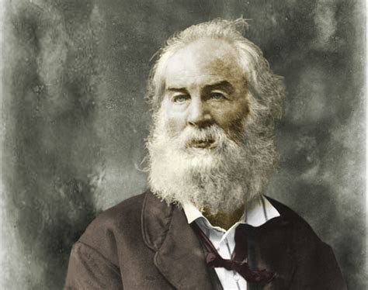
The Learn’d Astronomer
When I heard the learn’d astronomer, When the proofs, the figures, were ranged in columns before me, When I was shown the charts and diagrams, to add, divide, and measure them, When I sitting heard the astronomer where he lectured with much applause in the lecture-room, How soon unaccountable I became tired and sick, Till rising and gliding out I wander’d off by myself, In the mystical moist night-air, and from time to time, Look’d up in perfect silence at the stars.
Walt Whitman
1819-1892

Slide 12
Part I – SUMMARY Science and Its Psychological Effect
Pros and Cons of Enlightenment
Loss of meaning through reductionism, data-obsession, atomized man and nature
The naïve belief that a flawless, humanoid being and a utopian society can be produced from scientific knowledge . . . A digital society separates man from his world.
An overreliance on measurement leads to bias and a belief in narratives that are not only wrong but also harmful – also leads to people incapable of recognizing contradictions in their beliefs and blind to counter -- even as 85% of studies are incorrect.
Imagery and symbolism, offer a better grip on reality than any logical, rational discourse.
Notes:
People believe the technology and technocrats should lead during a crisis..
Can’t reduce and categorize things around you. There’s a limit. When you’re logical, connect everything from dot to dot, you have a closed system, but life isn’t closed – it’s irrational.
-- Heisenberg uncertainty principle – ”it’s impossible to determine facts – relinquish the illusion that man can ever attain certainty…. All the great scientists finally came to the belief that truth cannot be discovered through measurement. …. The great minds who followed reason and facts concluded “the essence of things is beyond logic and cannot be grasped.”

Slide 13
Let’s Discuss
Have we embraced technocratic comfort at the expense of meaningful community and ethical clarity?
Think of a time you felt swept by a public narrative (any issue). What cues told you “this is becoming team identity, not truth seeking”? What did you do about it?
In a culture where propaganda is indistinguishable from truth and the measurements of truth aren’t trust-worthy, how do we move towards truth-telling?
Given the view that technological advancements come at a price, including a weakened connection to our natural and social environment – what might be the result of a world immersed in AI and Transhumanism?
Notes:
“the last century has produced an abundance of ideologies that pretend to be keys to history but are actually nothing but desperate efforts to escape responsibility.”
― Hannah Arendt, quote from The Origins of Totalitarianism

Slide 14
Part II – Mass Formation and Totalitarianism
Three primary conditions for mass formation:
Loneliness
Lack of meaning
Free-floating anxiety
Frustration and aggression
Atomized individuals are vulnerable to collective narratives
Leaders emerge to channel anxieties into unified direction
Crisis narratives justify suppression of dissent and increase control
Social pressure, stigma, and groupthink reinforce conformity

Slide 15
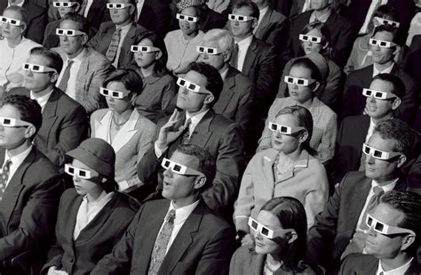
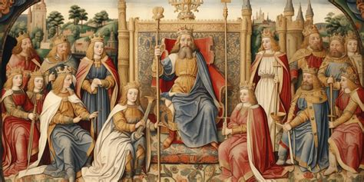
THE RISE OF THE MASSES
Summary of Totalitarianism
Summary of Authoritarianism
Total control over all aspects of life, public and private
Guiding ideology that influence citizen thought and actions
Suppresses all forms of political dissent and opposition
Instills fear to maintain control
Control primarily over private with some allowance of freedom
No strong ideological basis
Limited political pluralism
Blind submission to authority with little fear

Slide 16
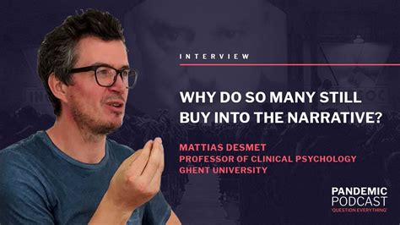
Desmet’s Theory
of Mass Formation
“Mass formation is, in essence, a kind of group hypnosis that destroys individual’s ethical self-awareness and robs them of their ability to think critically.”
Characteristics of Totalitarianism
Leading to Mass Formation
Instilling fear of physical aggression
Fear of unilaterally imposed social contract
Notes:
Mass formation has a huge impact on individual’s cognitive functioning
The only explanation why even highly intelligent people don't question the narrative and the “statistics” that were in many respects utterly absurd.

Slide 17



Desmet’s Theory of Mass Formation
CORONA VIRUS
The Perfect Storm
THE SET-UP–
‘free floating’ discontent and anxiety
Increase in antidepressant use
'bullshit jobs’ (60% say jobs are meaningless)
Minister of Loneliness (UK)
Mental illness and suicide increase
THE CRISIS --
Provided a clear object of fear (the virus)
'War on COVID' gave meaning, purpose
Covid Strategies (masks, vaccines, distancing) created a new social bond
Dissenters provided a threat to social bond and purpose

Slide 18
Modern Symbols Leading to Totalitarianism
Technocratic Totalitarianism
Intrusive actions by security agencies
Surveillance society
Struggle to maintain right of privacy
Citizen snitching
Censorship

Slide 19
CONDITIONS LEADING TO MASS FORMATION
Loneliness and Isolation
Lack of Meaning in life
Anxiety and Psychological unease
Frustration and Aggression
“Totalitarianism is not about monstruous people – it is about people who stick to a morbid, dehumanizing way of thinking or “logic.”

Slide 20
Let’s Discuss
In that Mass formation’s pre-conditions are loneliness, loss of meaning, and free-floating anxiety -- which do you see as most combustible today, and what everyday practices actually reduce it?
How do we sustain independent thought and real conversation in an age that rewards conformity?
The policies and actions of the previous and current president are considered “totalitarian” or “authoritarian” by many. What led to these accusations and how are the two administrations different in this regard?

Slide 21
Part III – Beyond the Mechanistic Worldview
Mechanistic ideology overlooks consciousness, morality, meaning – It puts people into social isolation, lack of meaning, free-floating anxiety which is transformed (by way of a totalitarian state) into an illusion of connectedness
Truth is not identical to what is measurable – the choice to confront the struggle of survival in a machine-based efficient manner culminates in a totalitarian-technocratic machine government in which ethics and principles are a hinderance, not a merit
The Rationality of “Enlightenment Humanism” is a masquerade (under the mask is irrationality). Example: 35,000 children starving to death/day vs fear of a Coronavirus by which we’ll give up civil liberties and take a dangerous medical intervention.
Incorporate symbolic, ethical, and spiritual dimensions into our lives
Realize that personal responsibility and dissent are antidotes to totalitarian drift
Notes:
The world is seen from Big Bang onward as a dead mechanistic process, an enormous chain reaction which continues endlessly without meaning or purpose and somewhere along the way produces life and mankind -- Naïve world view.
Heisenberg: Not only is the universe stranger than we think, it is stranger than we can think.”
Water droplets; CANTOR DUST – (dividing a line in 3 then omitting middle line)--Mandelbrodt finding a pattern in random noise (by unrelated external factors) over the telephone line
Need for humility and acceptance of uncertainty – “The more accurately in time an elementary particle is positioned, the more uncertain it’s location in space” (Heisenberg)

Slide 22
Let’s Discuss
Could Kirk’s death function as a catalyst for a spiritual renewal? What human needs (belonging, purpose, meaning) does that meet?
Does Erika Kirk’s public act of forgiveness introduce a social script different than that which we’ve become accustomed? In Desmet’s terms, does visible forgiveness disrupt mass formation? “Forgiveness is the key to action and freedom.” - Arendt
Why might it be possible for a shared reality and truth to emerge following the Kirk assassination? What could interfere with this outcome?
Notes:
Fourth industrial revolution – man is expected to physically merge with technology – transhumanism, internet of bodies – body is digitally monitored, tracked and traced by a technocratic govt to master the problems of the future – those dissenting are naïve and unscientific.
Refusing to go along means you lack civic sense, think you are more important than the collective. – Your health is no longer your business because it affects others.

Slide 23


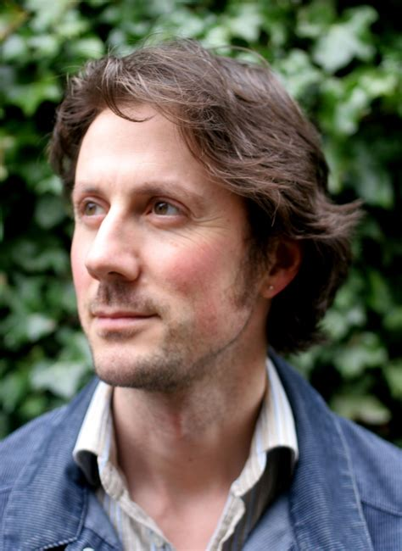
Thank you
for participating and sharing your ideas
Next Book – October 29th 7:00 PM ET
Karen.Howes@fairforall.org
Arnold.Huntley@fairforall.org
The book takes us from the First Industrial Revolution to the rise of artificial intelligence, showing how the hollowing out of humanity has been a long game, and how our very soul is now at stake.
Paul Kingsnorth is an English novelist, essayist, and poet based in the west of Ireland, known for probing the cultural and spiritual costs of modernity. Served as deputy editor of The Ecologist.
Notes:
If you have book suggestions or questions about how to host a FAIR book club for your friends or community, contact Arnold or Karen

Slide 24


SUPPORT FAIR
https://www.fairforall.org/donate/

Slide 25
