Slide 1
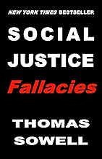
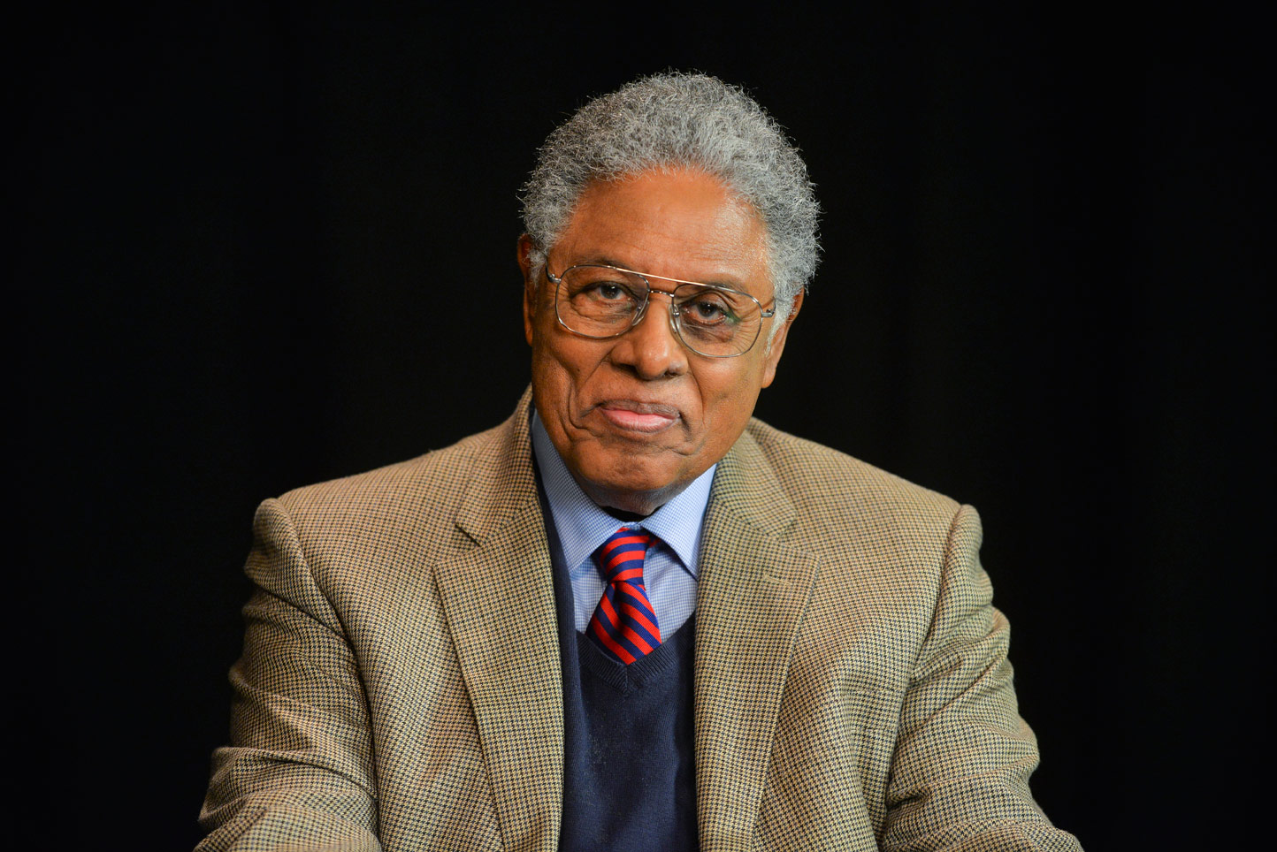
A National Treasure
Syndicated Columnist
Social Theorist
Senior Fellow at the Hoover Institution (Stanford)
Ph.D. in Economics, University of Chicago, 1968 A.M. in Economics, Columbia University, 1959 A.B. in Economics, Harvard College, 1958

Slide 2
OVERVIEW
Failure of the progressive Social Justice ideology and movement
Facts and data over rhetoric and faulty ideology
Social Justice efforts often lead to the opposite of desired results
Elitist thought enacted within societal institutions and the negative consequences

Slide 3
THE FALLACIES
"Equal Chances"
Racial
Chess Pieces
Knowledge
Words, Deeds and Dangers

Slide 4
"EQUAL CHANCES" FALLACIES
Fallacy One
All classes, races and other subdivisions of the human species would have equal chances in all endeavors (other things being equal).
Sowell...
"Even in a society with equal opportunity – in the sense of judging each individual by the same standards – people from different backgrounds do not necessarily even want to do the same things, much less invest their time and energies into developing the same kind of skills and talents."

Slide 5
RACIAL FALLACIES
Fallacy Two
Black Americans are victims of racism and therefore suffer debilitating income disparity and poverty.
Sowell
Black American have prospered.
Historical hindrances:
Failed Progressive policies
Elitism (Woodrow Wilson)
Eugenics (IQ)
Generational grievance
Substandard education
Single-parent families

Slide 6
DISCUSSION
What are YOUR perspectives on:
All ethnic groups having equal chances for economic success
Other factors that contribute to success or failure despite “equal chances”

Slide 7
CHESS PIECE FALLACIES
Fallacy Three
Government, acting as a social surrogate, can strategically implement laws and policies in society in the name of social justice.
Sowell
The desirable goals are often not feasible
Taxing the rich is more of a play to get votes – the rich navigate around paying more
Price controls been tried and failed
Minimum wage laws do more harm than good

Slide 8
KNOWLEDGE FALLACIES
Fallacy Four
Ultimate societal knowledge comes from an elite class of experts. Government as an empowered surrogate to rescue victims (the Government knows best).
Sowell
Existence of consequential Knowledge (experience, relational, historical)
Redefinitions of words for justice purposes (democracy, freedom)
Judicial activism

Slide 9
DISCUSSION
What are YOUR perspectives on:
The role the government has played in perpetuating the social justice movement
The way terms such as "Democracy", "Crisis" and "Constitution" are used within the context of social justice

Slide 10
WORDS, DEEDS AND DANGERS
Fallacy Five
The majority of people think the same and have the same vision to right the wrongs of society. How people acquire success must be scrutinized for exploitation.
Sowell
There are different beliefs about circumstances and assumptions about causation
Social justice effort full of false and untested rhetoric (use of "racism)
Setting up minority students for academic failure

Slide 11
CONCLUSION
Key Takeaways
The social justice movement makes assumptions that are not factual nor empirically supported by genuine data
Elites acts as surrogates within academia and government to make ultimate decisions on disparity causation and the solution
Black Americans are not as socially debilitated as academia and governmental institutions would have you think

