Slide 1
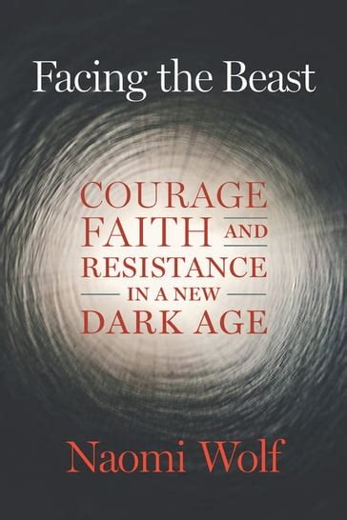
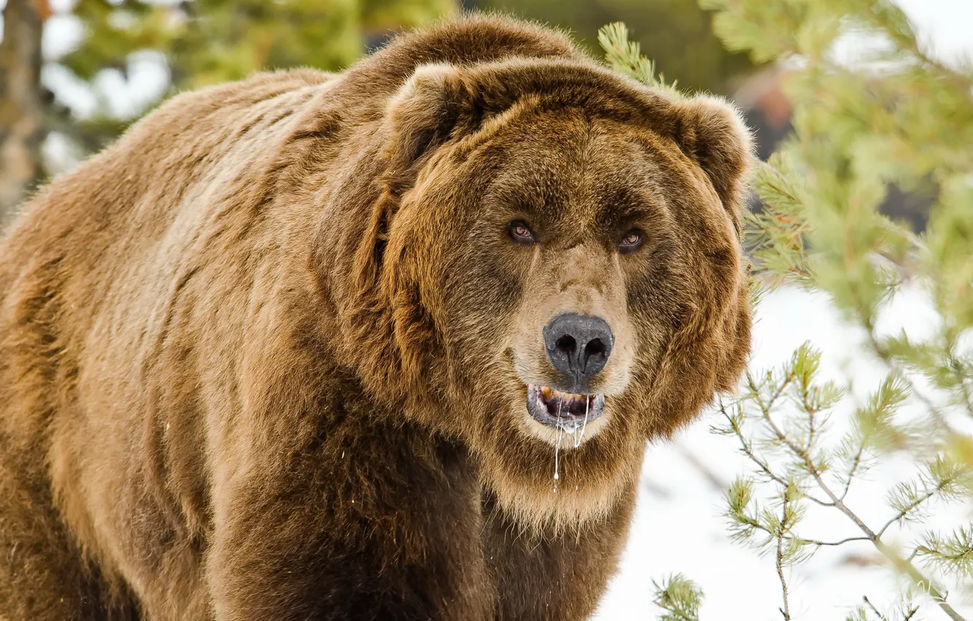
FACING THE BEAST
By - NAOMI WOLF
Before vs After 2020
The West lived through something catastrophic for the last three years that will change its nature if we don’t witness it and name it for what really happened
“If I don’t look out the window, the beast won’t be there.”
Published 11-2023
Notes:
Progressive feminist scholar, speaker and author of 8 books who started asking questions at the beginning of Covid (like she had as a journalist for countless events in the past), to find herself de-platformed, censored, ridiculed and banished/ousted by her friends and colleagues from her political, media and academia circles.
1/3 personal memoir/ testament to work through her own personal confusion and rage
1/3 analytical indictment of the failed and corrupt institutions, policies and leaders who made decisions during Covid
1/3 theoretical investigation into the why and how the pandemic response rolled out as it did….

Slide 2

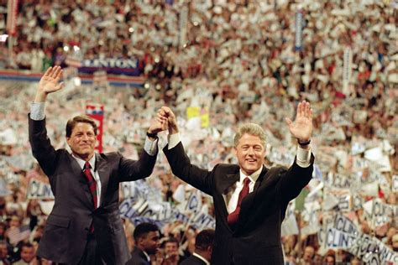
NAOMI WOLF
Graduated from Yale in 1984 and was a Rhodes scholar at New College, Oxford University.
Author of the bestselling feminist books, "The Beauty Myth", "Fire with Fire", "Promiscuities“, and "Misconceptions".
Consulting editor at George Magazine. Her essays appeared regularly in The New Republic, The New York Times, The Wall Street Journal, The Washington Post, Glamour, Ms., and other publications.
Counseled Al Gore during his unsuccessful run for the U.S. presidency in 1999, for which she was heavily criticized.
Advisory for President Bill Clinton’s1996 re-election bid.

Slide 3
NAOMI WOLF
. . . Wikipedia . . .
Naomi Rebekah Wolf (born 1962) is an American feminist author, journalist, and conspiracy theorist . . . She has been criticized for posting misinformation on topics such as beheadings carried out by ISIS, the Western African Ebola virus epidemic, and Edward Snowden.

Slide 4
Pre-cursor to writing “…The Beast”
Research and writing of “The End of America”(2007)
A blueprint for crushing democracies to enable the rise of tyranny
“The precedence for a militarized United States is in place.” It appears benign until it’s acted upon (many of the laws put into place by George W. Bush after 9-11).
Real journalism, the asking of questions, led to de-platforming and censorship
Gov’t, media, academia, her liberal friends’ response to the pandemic
Gov’t, media, her friends’ perception and actions surrounding January 6, 2021
Reading and reporting on Pfizer’s documents (450,000 pages)
China’s involvement
Notes:
1933 - german parliment set on fire (staged). Enabled socialist party to subvert constitution (open mail, listen to phone calls). Not patriotic if you don't agree....
Fosun Pharmaseuticals - partnered with Pfizer/bio-ntech and makes the PCR tests. A ccp run company; also makes Merk’s Molnupiravir (US bought $5.29 billion worth for 10 million doses. SEC filings show 100% tech transfer from Bio Ntech to Fosun; exactly where the virus originiated. – we need to snap out of denial and see what’s been happening.

Slide 5
Chapters
Introduction
1. A lost Small Town
2. Opening Boxes from 2019
3. What is a Miracle?
4. Principalities and Powers
5. Thinking Like a Tyrant
6. The Subtlety of Monsters
7.White Feathers
8. Rethinking the Second Amendment
9. The Next Thing
10. The Pfizer Documents
11. Facing the Beast
12. Thanksgiving Gathering
13. Twenty Will Not come Again
14. How Lies Killed Books
15. Rock of Ages
16. Have the Ancient Gods Returned
17. A Fall
18. Dear Conservatives, I Apologize
19. Red Sparkly Shoes
20. The Last Taboo
21. Not Dead Yet
22. Soup
Epilogue
Notes:
1-5 dealing with the atrocities and bewildering infractions against freedoms, health, friendships, loyalties…. rage, sorrow, bewilderment, struggle to forgive
5- applying reason and logic in order to understand what was/had been taking place

Slide 6
Thematic Overview
America is at an historic crossroads
There has been a systematic deployment of policies and lies to end Democracy
The government, media, and the elite class are complicit in lying to the public
The battle is a moral one of good against evil
Being aware (awakened) of the truth is personally transformative – we all need to snap out of denial and see what is transpiring around us
Notes:
Other themes ??

Slide 7
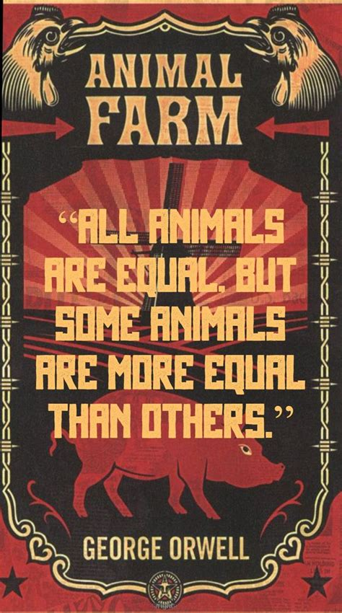
Introduction
Separates the world into Before 2020 (and after)
After 2020 marked by:
Lies
Censorship
The Left’s disregard for human rights, critical thinking, science, free speech, skepticism in which some people are more equal than others “Animal Farm”
Media stopped asking questions and being a watchdog over government, corporations, and elite powers. They acted in lock-step to support the people they were supposed to oversee.

Slide 8
Introduction
Policies brought into play by “pandemic””
Mass censorship, surveillance, forced closings of schools, worship, businesses
Disallowing assembling (homes, holidays, nursing homes, hospital rooms)
Violation of bodily integrity, informed consent, and Nuremburg Laws thru mandates
Subjecting people to propaganda, fear, mandates, discrimination (Jim Crow Laws)
Arresting and jailing people without due process (Jan 6) and outside rule of law
Vaccines as only way out of Pandemic (Moderna’s website in 2020 – enters every cell in the body)… demonization and scapegoating of unvaccinated
Personal shaming, shunning, and destruction of reputations
Embracing Marxist concepts in our language: harm reduction; social distancing; collectivism; state as arbiter; freedom is a bad idea; it’s selfish to want individual rights; assembling is dangerous; State should control the flow and content of information – all under the guise of public health.
Notes:
Commandeering language – a technique used by psychopaths and narcissists to confuse, shame, intimidate and control

Slide 9
Introduction
List of heroes who had been on the left
Edward Dowd, Bret Weinstein, Peter McCullough, Pierre Kory, Glenn Greenwald, Joe Rogan, Robert Kennedy Jr; Drs Jay Bhattacharya, Martin Kulldorff, Sunetra Gupta (Great Barrington Declaration)…
Power in the hands of WEF, WHO, CCP, Big Tech, Govt Bureaucrats, NGOs (Gates Foundation)
America is still the free-est country in the world, but it doesn’t mean we aren’t in danger

Slide 10
Introduction
Noteworthy Excerpts
“Facism does not descend overnight, but moment by moment, loss by small loss” (p. 11).
“…Pfizer committed the greatest crime against humanity in recorded history; with a special focus on destroying the reproductive capacity of human females” (p.10)
“We are not in a normal time of normal bad human politics” (p.11)
“The bad guys are not done with us. Their goal is still a global feudalism” (p.12). . .
continued existential threats to liberty and survival: GMO Mosquitos, WHO treaty, democide
“… a story of my cancellation, my survival, my witnessing of an all-out attack on humanity, and my stumbling into an awareness of what holds us and upholds us all . . . humans fighting for humanity. . . in spite of it all, still can save us . . . thru love, care, intimacy . . .” (p.12)

Slide 11
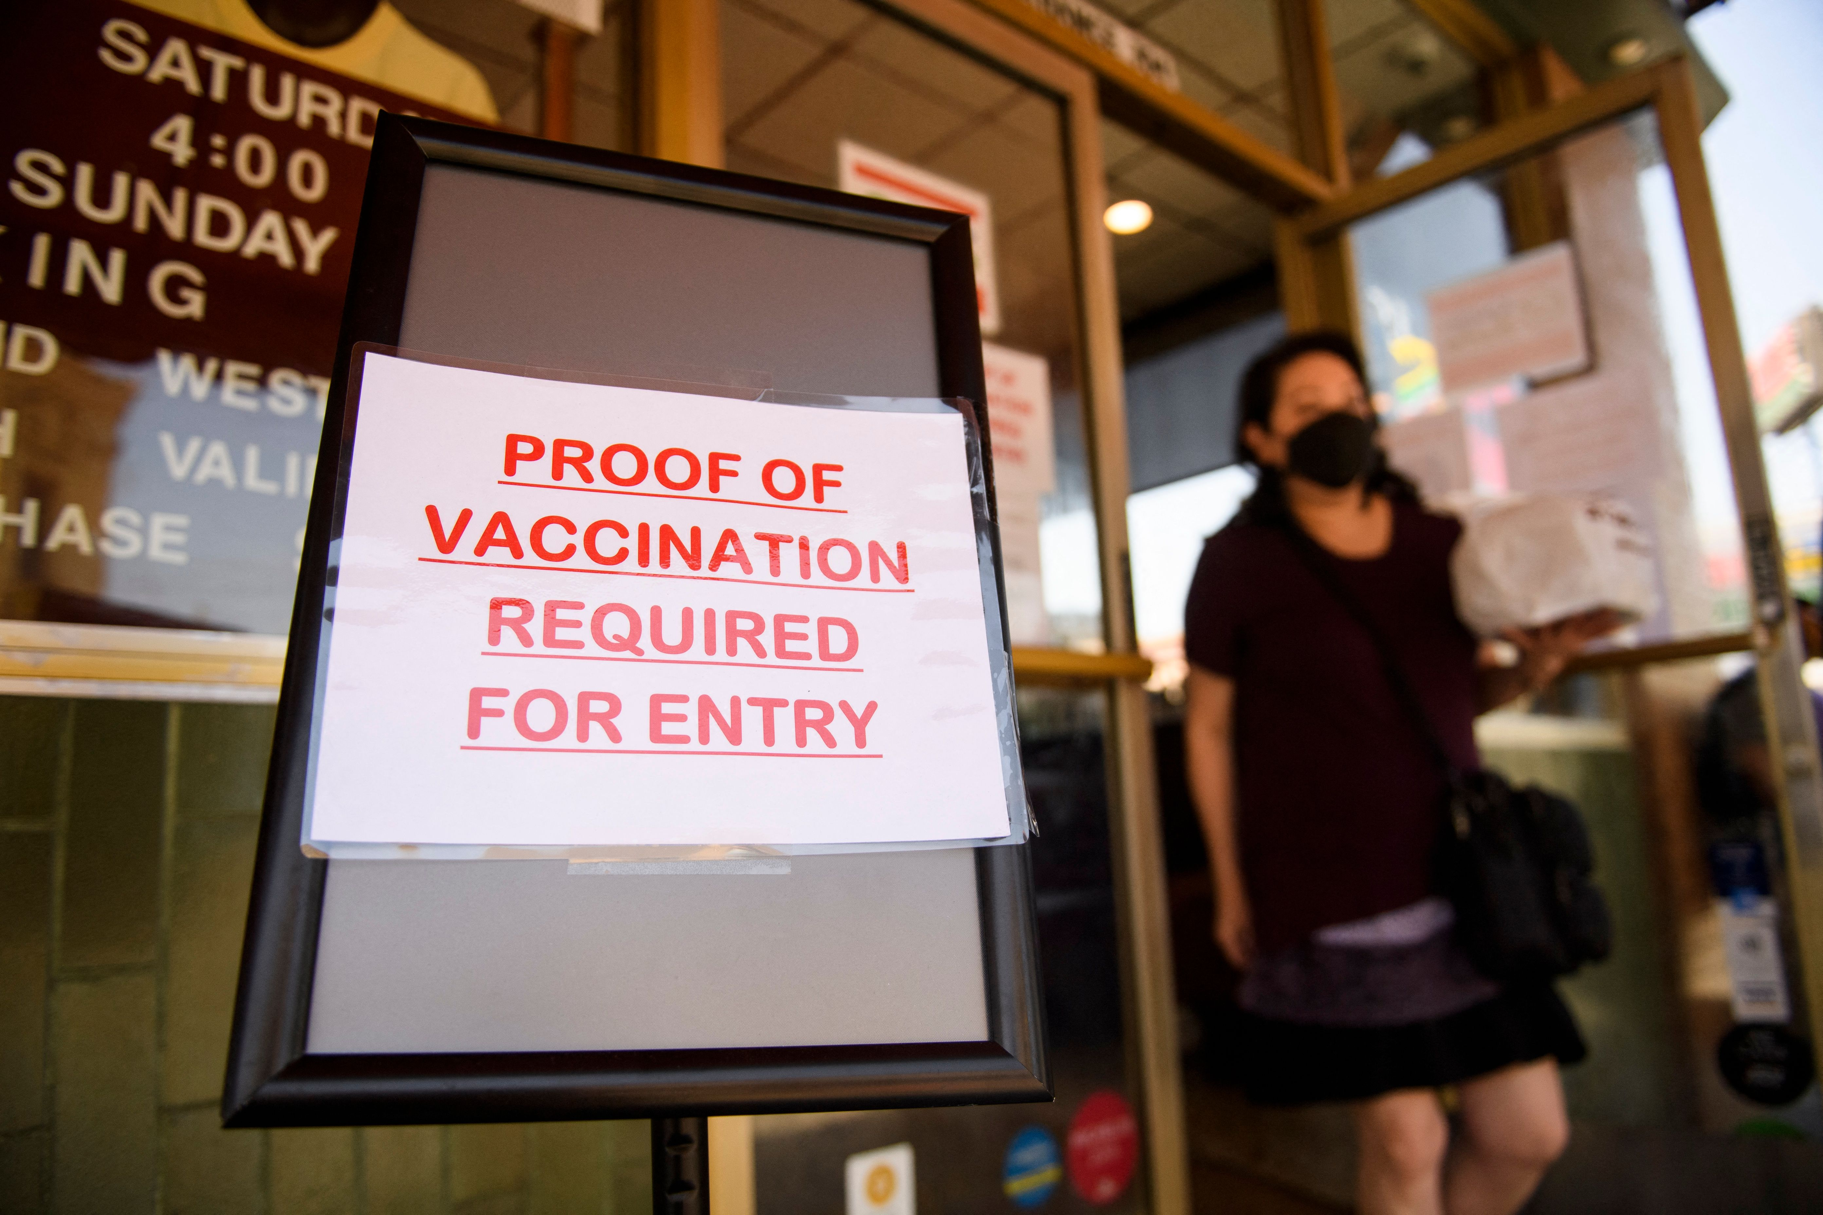


Chapter One: A Lost Small Town
I Forgive You
“Rage and Sorrow is exhausting”
Covid ushered into our world an emotional massacre, bullying, discrimination in which only the vaccinated were allowed to participate in society
“Are you vaccinated? Are you? Vaccinated? Are you naked? Are you mine, my possession?”

Slide 12
Chapter One: A Lost Small Town
Janine Small (Pfizer, president of international markets), October 2022 to EU: “The MRNA vaccines were never tested to stop transmission” (p.15)
”…transmission is known to be a lie and the “vaccines’ efficacy itself is known to be a lie – are they sorry?” (p.15)
“I forgive my loved ones for keeping us from the Thanksgiving table. I forgive my best friend for leaving the country without saying goodbye…. It was my risk, my body, my decision, my life…my heart broke” (p.17)
“They took the money and there is blood on their hands” (p.19) – (the universities, the hospitals, the doctors, the governors, the journalists, the schools, the pharmacists . . .)

Slide 13
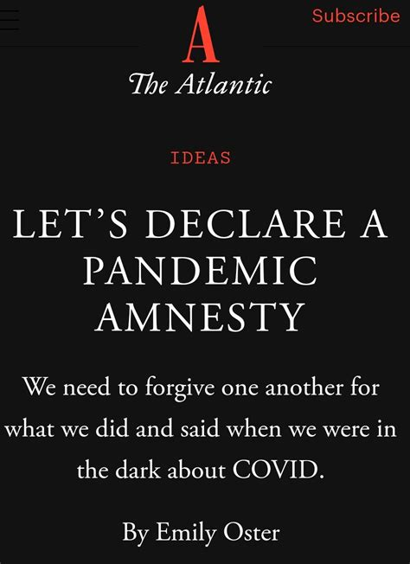
Chapter One: A Lost Small Town
“The people who got it right, for whatever reason, may want to gloat. The people who got it wrong, for whatever reason, may feel defensive . . . Treating pandemic choices as a scorecard on which some people racked up more points than others is preventing us from moving forward. We have to put these fights aside and declare a pandemic amnesty” – Emily Oster
“…Or, no. It’s not about a “scorecard.” It’s about a series of crimes. Let there be no misunderstanding. “Amnesty” for crimes of this severity and scale is not an option. There was no group hug after the liberation of Auschwitz” (p.18) – Namoi Wolf

Slide 14
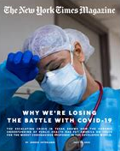
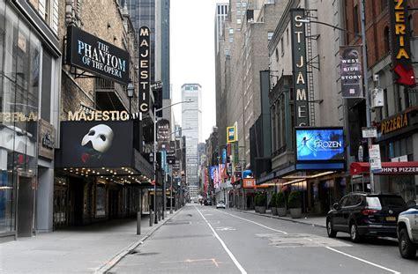
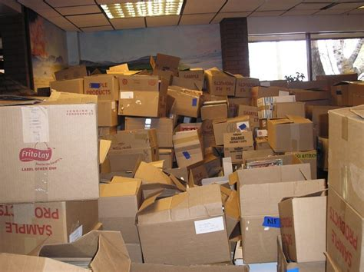
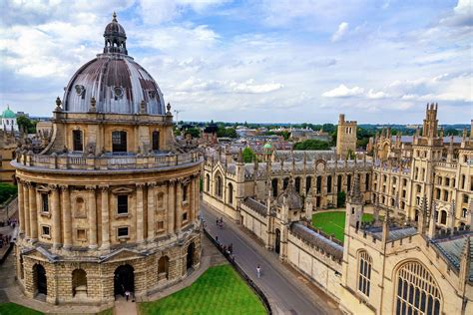


Chapter Two: Opening Boxes from 2019
”The major newspapers? – shills for genocidal imperial powers.”
“Worlds of authority that had seemed sparkling and real in 2019 revealed themselves to be seething with rot.”
“Long-revered institutions had lost all morality and authority.”
“Oxford had complied with the requirement that its students endure online learning…an institution that survived plagues and epidemics…wars and revolutions, that had nobly taught students in the face of crisis.”

Slide 15
Chapter Two: Opening Boxes from 2019
“I had been made a non-person overnight. . . CDC had colluded with Twitter . . . The federal government is stunning, especially in collusion with the biggest content companies in the world” (p.27) -- Missouri vs Biden-WH colluded with Tech)
“It is a post-truth world. A post-meritocracy world” (p.28)
“A new constellation of friends … more personal freedom now than I did as a member of the most privileged class…My former elite network paid lip service to diversity, but there was a deadening sameness and conformity” (p.29)
“I now work with people who... are sterling human beings, protect the cherished ideals of … America… what unites them is the excellence of their characters” (p.29)
“I no longer want to sit at a table with people who are okay with the murder of children, the poisoning of breast milk … the ruination of women’s fertility… who took money to damage … revealed as monsters and barbarians” (p.29-30)
“The institutions the boxes memorialize are dead” (p.30)

Slide 16
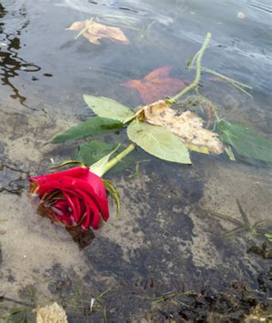
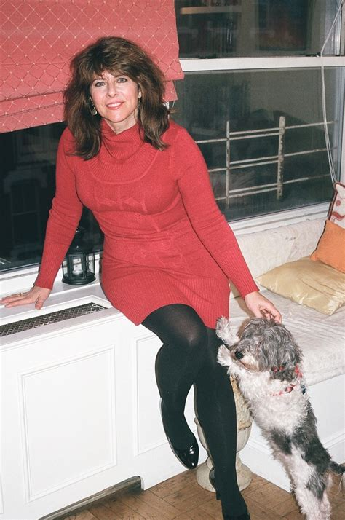
Chapter Three: What is a Miracle?
“I don’t think I’ll love anyone who is coming over to euthanize my dog” (p.31)
“Not allowed to be with our elders, not even to hold their hands. . . a sense of wrongdoing, of negative, inharmonious, even profane forces around us” (p.32)
“Wrestling with the vast crimes committed against humanity … overwhelmed…monumental powers arrayed against humanity… How can we ever overcome such adversity?” (p.34)
“Don’t be so silly. Just look at me” (p.35)
Are miracles always around us and we just don’t notice?
Naomi and Mushroom
Notes:
Prayer to Virgin Mary (even as Jewish); showed mushroom’s empty body … did my subconscious produce a meaningless wish fulfillment wish? Did a neighbor dump trash in which a rose hovered for 10 days then dissipated upon Mushroom’s passing? Was the miracle the rose itself? Or that I noticed it enough to research Mary and Saint Theressa? A miracle to be devastated and defeated about the state of the world and the crimes against humanity to look up and see a blaze of gold light or was the light always there?

Slide 17
Chapter Four: Principalities and Powers
The Left-Woke cult became more insular with vax-only parties, while the medical freedom advocates gathered freely.
Mainstream journalists, doctors, teachers, therapists refused to look at alternative information and were no longer skeptical of big industry, gov’t, power brokers, and money makers
No care for female health (ignored reports of vax spike accumulating in ovaries). Example: Heidi Murkoff (female health advocate warning against smoking and eating sushi while pregnant) sided with Big Pharma and CDC supporting mandates for all women
Those who argued for bodily autonomy in Roe vs Wade defended mandates, constructing an edifice of discrimination and a two-tiered society.
Collective hallucination akin to the 15th century witch-craze

Slide 18
Chapter Four: Principalities and Powers
Theory: “The edifice of evil was too massive, too quickly erected, too complex, and too elegant, to assign only human awfulness and inventiveness….sudden dropping of post-Enlightenment norms of critical thinking, dilution of parents’ sense of protectiveness over the bodies of their helpless children, acceptance of a world in which people can’t gather to worship…..policies aimed at killing children’s joy…suffocating children…killing ties between families; killing churches and synagogues and mosques” (p.43-44)
Intellectuals, artists, philosophers, artists used to speak about God – now, its taboo.
“We wrestle not against flesh and blood, but against principalities, against powers, against the rulers of the darkness of this world, against spiritual wickedness in high places” - Ephesians 6:12
We’re at an unheard-of moment in history and we need help!
Notes:
Metaphysically frightening – spiritual battle taking place through humans. Following existentialist intellectual thinking, talking about God and Satan (Jewish “the Accuser” became taboo.)
“Don’t kill grandma by hugging her” – in 150 languages all at once.

Slide 19
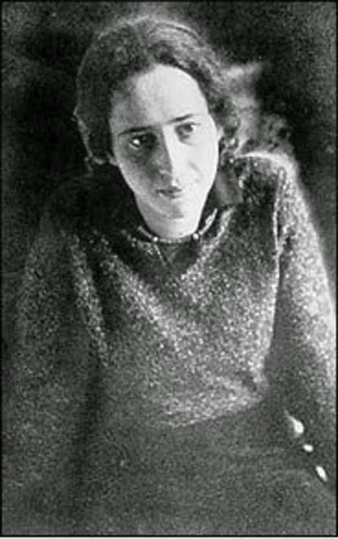
Chapter Five: Thinking Like a Tyrant
”They” don’t think like we do: Hannah Arendt
“Evil comes from a failure to think. It defies thought, for as soon as thought tries to engage itself with evil and examine the premises and principles from which it originates, it is frustrated because it finds nothing there. That is the banality of evil” (p.48)
1905-1975
German/American philosopher
on Totalitarianism – Power and Evil
Meta-national organizations (UN, EU, Hedge Funds, Tech) breed a cadre of global elites who can create oppressive policies because they are at a distance from the people and not elected.
We are no longer a representative democracy if those making policies are not elected and if those voting are not citizens.
A tyrant’s dream is diluting the power of citizens and the accountability of policy makers.
Notes:
People are making mistakes in their reasoning due to“mirror imaging” – thinking that others are like them and not sociopaths and psychopaths.
Shaming citizens for being proud of their country.
1963 Psychology Shock experiment by Stanley Miligram (65% give near fatal shocks to innocents if ordered by authority and shielded from victim)
Greece’s referendum (will of the people for austerity) - eu didn’t care. PM: “We couldn't overcome the bankers and northern European elite who have absolute power in this continent."

Slide 20
10 Steps to Tyranny
A blueprint for turning an open society into a dictatorship.
Invoke a terrifying internal and external enemy
Create a gulag
Develop a thug caste
Set up an internal surveillance system
Harass citizens' groups
Engage in arbitrary detention and release
Target key individuals
Control the press
Dissent equals treason
Suspend the rule of law
Notes:
From “End of America” (reaction to Bush’s policies following 9/11 and the forming of Homeland Security)

Slide 21
Chapter Six: Subtlety of Monsters
SINCERE WARNING -- a pause, but not over
“evil isn’t done with us”
Fertility harms (births down 13-20%); CBDC, 15-minute cities, confiscation of farm-land, smart cities, climate-related lockdowns, fires at food processing plants, food supply shortages, lab grown meat, heightened racial issues, sexualization of children, human trafficking, Fentanyl crises, open borders in US and other countries marked by a great influx of migrant people, forcible quarantine without trial…
Hitler knew what was needed to turn a government into a legal dictatorship – Emergency Powers under Article 48 (in 2021, 47 US states were operating with emergency powers which suspended or bypassed normal legislative checks.
Democracies die with a thousand cuts
Notes:
2020-2022 parallels 1931-33 Germany (development of two-tier society thru imperceptible shifts in policies and culture) p.58
unvaccinated were considered “unclean” – not allowed in restaurants or to be near others. Not to be given healthcare or allowed in hospitals. In Canada, denied the ability to buy groceries in some places (had to order)
health boards had police powers.

Slide 22
Chapter Six: Subtlety of Monsters
SINCERE WARNING -- a pause, but not over
Overarching theme – the Pandemic ushered in a metaphysical level of evil
MORE QUESTIONS
How could the people who had always been for civil rights support plans to forcibly quarantine anyone (without charge or trial)?
How could these same people facilitate a two-tiered society?
REVIEW HISTORY
Similarities to Germany in1931-1933: building of social cruelty policed by doctors, journalists, filmmakers, artists, universities, neighbors, shopkeepers.
A Call by Theodore Wolff… “All decent people must form a common front”

Slide 23
Chapter Six: Subtlety of Monsters
SINCERE WARNING -- a pause, but not over – we must call out the MONSTERS!
Discusses the vaccine and how people were “forced” to take shots long after it was stated by Pfizer and known by the government that the shots didn’t stop transmission or infection.
Thousands of adverse events recorded by VAERS and VSAFE
Voices of opposition censored en masse (Neil Young vs Spotify re Joe Rogan)
Blame and hate the un-vaxxed
Therapeutics withdrawn by FDA; Medical boards sued for refusing to give treatment
Compare to Eugenics Themes in Nazi Germany:
“sterilize the unfit… cleanse the State: the devaluation and dehumanization of segments of the community…train physicians to identify with political goals of the government… shouldn’t be a drag on hospitals or public resources”
Notes:
Half of doctors joined the Nazi party.

Slide 24
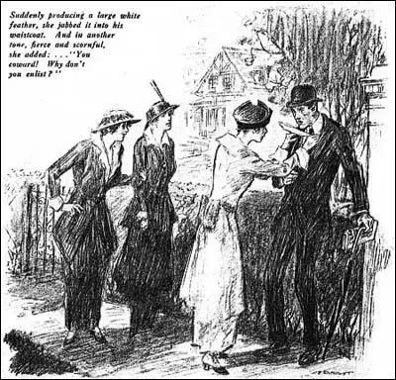
Chapter Seven: White Feathers
HEROES VS COWARDS
”Tyrannies only fall when there is mass resistance… when there are just a few, they are marginalized, silenced, smeared…arrested”
Tribute to
Dr Patrick Phillips (Canadian ER Dr) on harms of lockdowns, Dr Jay Bhattacharya (Great Barrington Declaration); Dr Peter Mcullough (Cardiologist); Edward Dowd (Blackrock re Pfizer’s fraud)
The working class - Truckers, Moms, Firefighters.
White feathers to
The virtue-signaling Zoom-class who showed ”monumental world-changing cowardice … for those who try to change the subject…. (rather than apologize or admit they were cowards)
Notes:
Dm’s saying Naomi was brave, but they couldn’t because ….
Martin Kuldorff (Harvard); Sunetra Gupta (Oxford); Pierre Kory, Harvey Risch, Pierre Kory, Aaron Kheriaty, and Robert Malone, Bret Weinstein, Joe Rogan. She talks about her own threat of arrest.
Class divide on who showed courage: not the professionals and the Zoom class, but the moms, the truckers, the firefighters, the cops

Slide 25
Chapter Eight: Rethinking the Second Amendment
“A well-regulated Militia, being necessary to the security of a free State, the right of the people to keep and bear Arms, shall not be infringed.”
“Because a well-regulated Militia is necessary to the security of a free State, the right of the people to keep and bear Arms shall not be infringed.”
“Tyranny is descending all around the formerly free nations of the world” -- The coup started, without a shot being fired, via Emergency Powers. “Formerly free people who are unarmed are defenseless against criminal tyrannies…”
WHO, WEF,“One-Health-Army” (mercenaries), Gates: Public Health given enforcement powers
Notes:
The militia is well regulated … she says that the people she knows who bear arms do not fit the stereotypes many take for granted.
Biden: Extended 2-2022 - Covid, May 2023 – Iraq, June 2023 – Balkans
Cuomo: March 2020 –Covid, July 2021 –Gun violence
Hochul: extended emergency powers month after month May 2023, August 2023

Slide 26
Chapter Nine: The Next Thing
Back to normal?! -- “simmering with rage”
The messaging about Covid through the elites was switched off (Midterms were more important).
But --- to have healing, there must be justice.
Recognize a betrayal of our social contract: Individual Sovereignty vs Harm Reduction.
Freedom isn’t free.
“The people you harmed, the parents of the children you harmed – they are coming. Not violently, not vengefully, but with the righteous sword of justice in hand…..You don’t get America back as if nothing happened.”

Slide 27
Chapter Ten: The Pfizer Documents
THE REAL CHALLENGE
Release of 450,000 pages from Pfizer in February 2022 (public health and medical professionals for transparency vs FDA).
3,250 highly accredited medical professional volunteers produced 89 reports
Pfizer/FDA aknowledged by 12/2020 that vaccines ”waned in efficacy,” not tested for transmission – Jane Small admitted to EU in 2022… had 13 pages of side effects single spaced, including getting Covid, myocarditis, Bells Palsy, Stroke…
Toxic spike protein and lipid nanoparticles didn’t stay at the injection site, went into the bloodstream, spleen, adrenals, lymph nodes, ovaries…warned about “exposure” (shedding) during tests
Pfizer lost records of 100s of trial subjects (out of 22,000 vaxed)
Pregnancy study based on 44 French rats followed for 42 days; 270 humans: 230 lost records; out of 34, 28 lost their babies (80%); now death in childbirth up 40%
Studies run by shareholders of Pfizer – still docs showed babies dying disproportionately
Notes:
Japanese contract – biodistribution study showed spike traveled into every part of the body

Slide 28
Chapter Ten: The Pfizer Documents
THE REAL CHALLENGE
Breast milk scandal: FDA closed Abbott formula factories (formula shortage) while gates, Bezos, Branson, Zuckerberg invested in BIOMILQ (lab grown)
“… looking into an abyss of evil humanity has not seen since 1945” --- anti-humans at Pfizer, FDA, WEF…”
Compares to Old Testament Biblical times / massive arrogance (Babel) against Divine plan
Inject their way into destroying the health and reproductive powers of the human body
Demons sauntering around in human form.
Monsters in the lab, on the transnational panels, are very skillful; and so powerful; and their dark work is so extreme.
What to do when humanity itself is threatened?
“Demand for shots dropped 89%” – as the reports and the individual experiences became shared

Slide 29
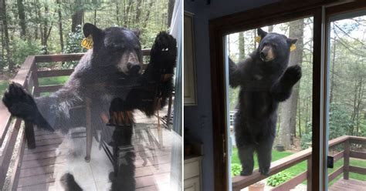
Chapter Eleven: Facing the Beast
“If I don’t look at the bear he won’t be there”
“He was there because I had done nothing to stop him…I let him slowly take over our home”
He became more and more comfortable walking around the house … habituated… marking his territory.
“More than medicine gone wrong and corporate greed . . . act of war”
Pfizer is a German-Chinese (CCP) company / MUA with Fosun Pharmaceuticals (100% tech transfer to China)
Hunter-Biden lap top Scandal – millions of $ from CCP to Biden family (Wash Post quote, p.109)
Notes:
Fosun also makes PCR tests which determines who can travel, go to work, school, be with family. Also makes Molnupiravir, Paxlovid
Crippling the US by its enemy – virus origination, testing apparatus, vaccines, lethal solutions to the virus from – brought to you by the govt that conducts forced abortions, organ harvesting

Slide 30
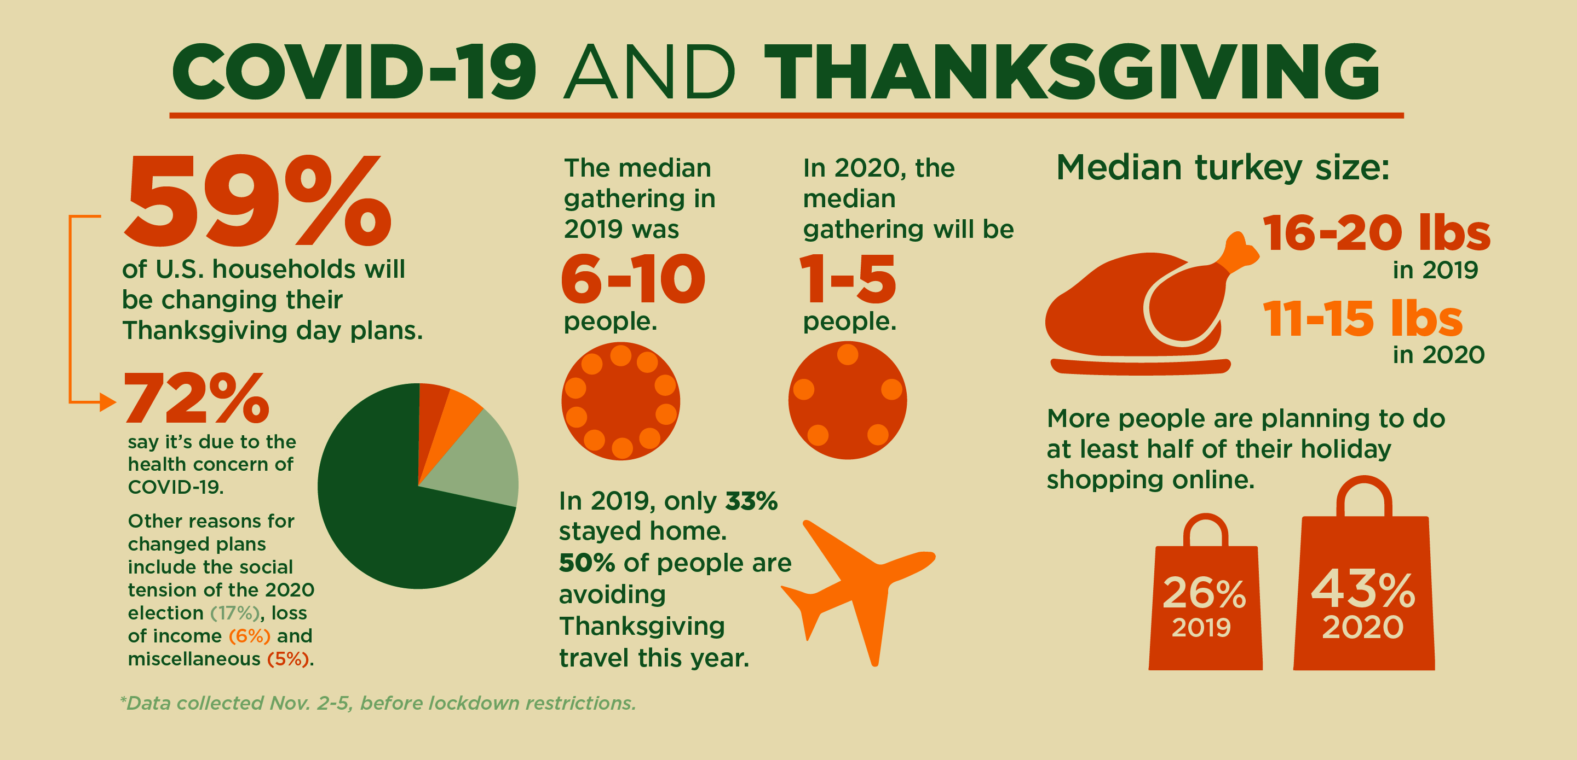

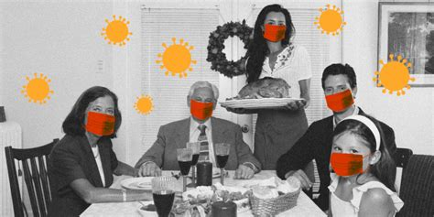

Chapter Twelve: Thanksgiving Gathering
For two years under government control – we were stripped of our powers to defend ourselves and our loved ones; stripped of our ability to earn a livelihood, to see friends and family
We became damaged and broken – existing in a shadow of fear
Fauci and Walenskys of the world knew better than you what was important in your life

Slide 31
Chapters 13-15
13: Overview of journalism – Gave speech at Yale on side effects and accused Yale of Human Trafficking re booster; defamatory interview by Yale newspaper; Pravda (no contact to editor) – Follow the money (Yale receives more $ from HHS than from tuition – $1.7b during Covid)
14: We fought for liberty, everyone gained – cognitive dissonance/denial …no books in the stores on the Pandemic by the usual scholars and writers; books published by others (drs, lawyers, researchers) but not displayed in bookstores = massive void in central thought processes. NYC intellectuals in a snow globe, unable to address reality, the lies, deception.
15: identifies commonality between Judaism and Christianity: Love is the only real miracle “I am here for you!” –
Notes:
Yale was demanding the booster – tested on 8 mice. Human trafficking: “Recruitment, harboring, transportation, provision or obtaining of a person for labor or services through the use of force, fraud, or coercion for the purpose of subjection to involuntary servitude, debt bondage, or slavery”. Yale students were forced to provide the service of “lab rats” or medical hostages.
Yale chair of Obstetrics and Gynecology said no evidence of side effects but evidence of death to babies if pregnant women didn’t take vaccine – lies!! The Yale paper printed his statement and not Naomi’s report based on 55,000 pages of Pfizer’s own documents in which 77% of side effects were to women’s ovaries.

Slide 32
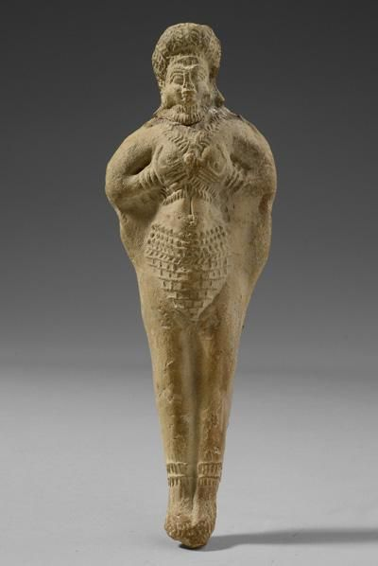
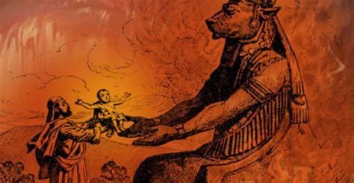
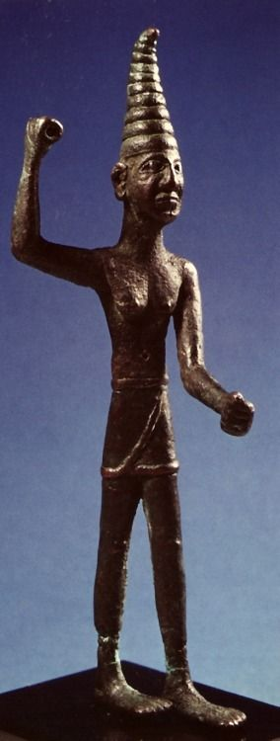
Chapter Sixteen: Have the Ancient Gods Returned?
THE CLUES:
that which could not be explained
Parroting a single script
Deception and lies - too quick and too ubiquitous
Obedience, Fealty, Praise and Loyalty - too quick and too ubiquitous
Transformation of hospitals as caring to killing factories (Remdesivir, death certs, $ incentives for ICU, vents, death)
Mass Formation Psychosis -
Moloch, Malek
Shedim- negative spirits not overcome just pushed to the edges
Astarte, Astaroth
sexuality, war
Ba’al
Weather, fertility
Notes:
Historical mass frenzy had dissidents, critics and skeptics – none lasted as uninterrupted delusional paradigm.
Johnathon Cahn “Return of the Gods” – pagan gods of antiquity have returned.
“Communism at its variants is the ultimate manifestation of the spirit of Baal at a political level as it seeks to control and enslave people…”
Marx: I will be able to walk triumphantly / Like a god, through the rains of their kingdom / Every word of mine is fire and action / My breast is equal to that of the Creator.
Baal: fertility god and god of the weather and was often portrayed with a thunderbolt in his hand.
https://www.redlandsdailyfacts.com/2007/01/11/baal-ashtoreth-and-molech-gods-old-testament-rivals/
https://opentheword.org/2018/10/10/was-it-a-coincidence-or-was-there-something-sinister-behind-the-arch-of-baal-recently-set-up-in-washington-dc/

Slide 33
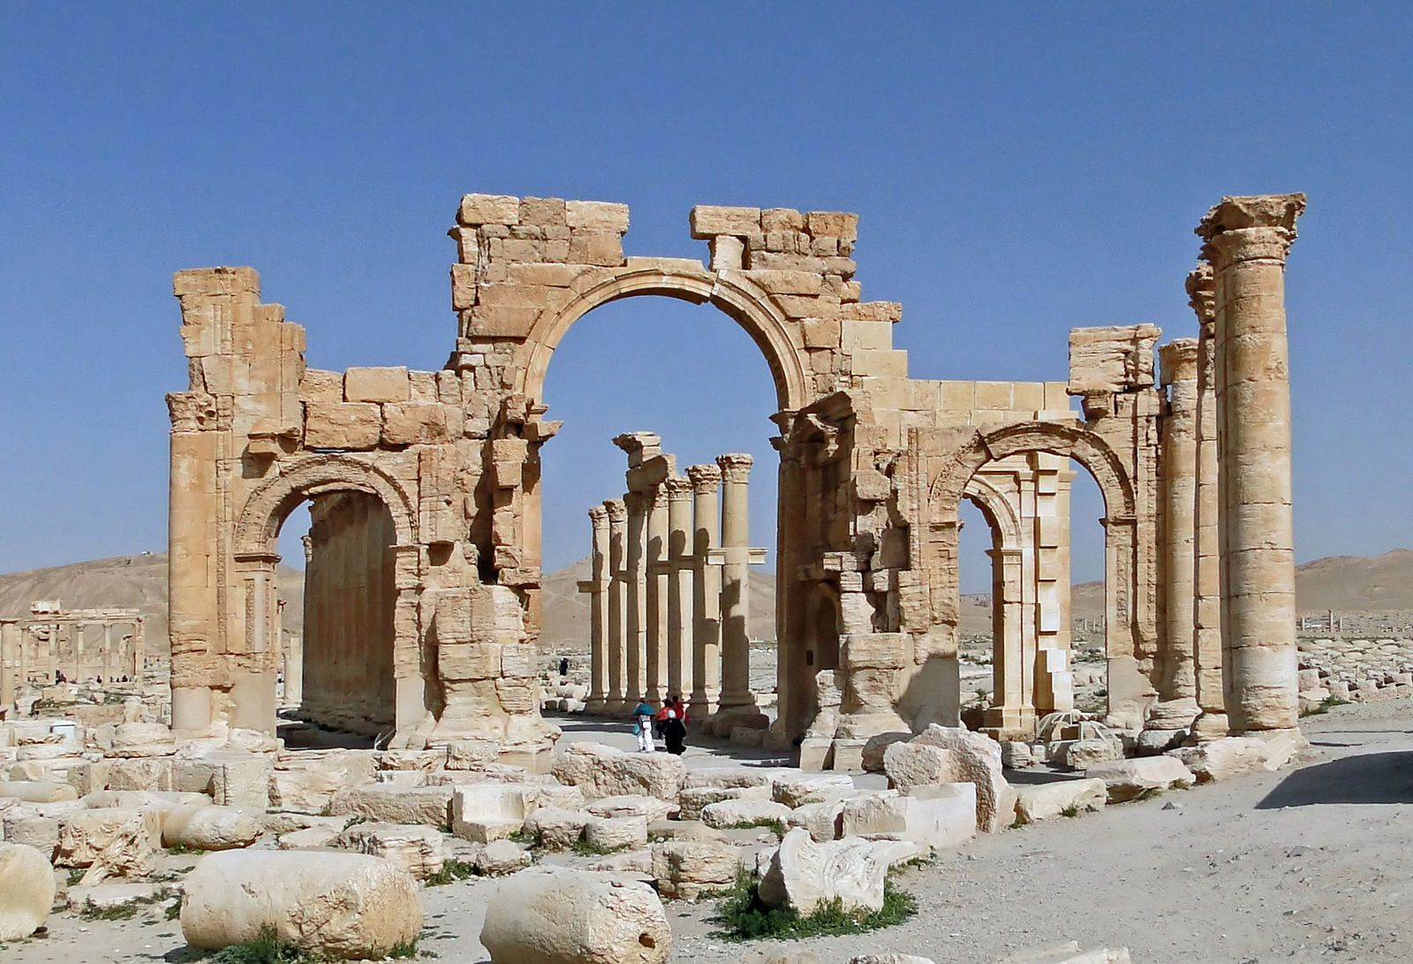
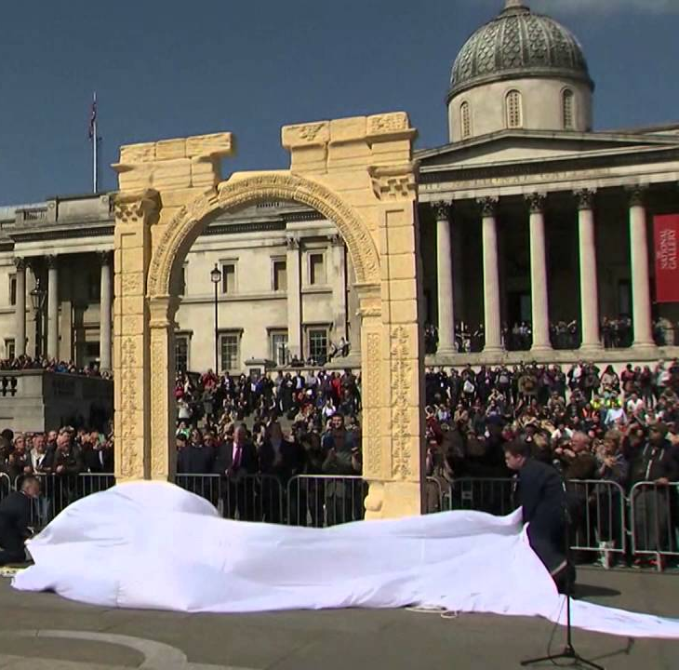
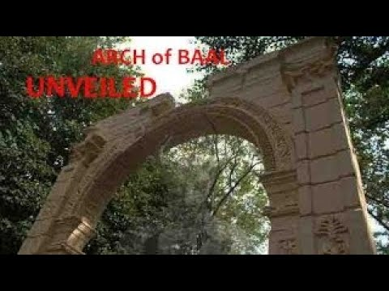
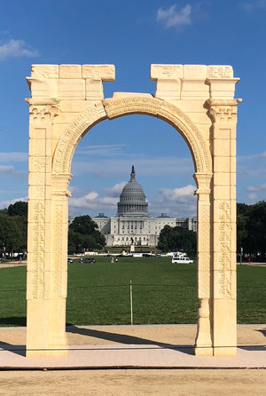
Chapter Sixteen: Have the Ancient Gods Returned?
“When a civilization turns away from God, it always ends up bringing in other gods in His place.” – Johnathon Cahn
Syria
America – “a nation that once knew good and evil, but now calls evil “good” and good “evil,” a nation that offers its children as sacrifices and a nation that persecutes the followers of God.”
The covenant between man and God, and obeyance to the 10 commandments didn’t provide “an eternal hall pass”
London, 2016
NYC, 2016
D.C., 2018
Notes:
Johnathon Cahn’s “Harbinger” -- https://www.youtube.com/watch?v=Xktx7MD2SnE
The coming age of the antichrist will be a time of great apostasy, of hatred against the people of God, when immorality and degradation of all that is pure will be praised, when all innocence will be defiled. It will be an age where only those who bow to the antichrist will be in positions of power.
QUESTION: - it was within monotheistic culture that we experienced great atrocities: witch hunts, slavery, medieval kingdoms/serfdoms, imperialism, plagues, holocaust, atomic bombings, crusades/Spanish inquisition, Native American genocide, Rwanda…. Is the current God more merciful and peaceful and “good” than His pagan predecessors?

Slide 34
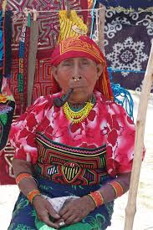
Chapter Sixteen: Have the Ancient Gods Returned?
Before 2020: “Congresses, parliaments, nonprofits organized along what were basically Judeo-Christian ethical frameworks: Respect for human rights, equal value of all, cherishing life, seeking of peaceful society”
After 2020: “we are terrifyingly grappling with. . . (a world) bathed, infused, bombarded with intensely powerful energies … that may derive from a pre-Christain, pre-solidly Jewish time.
“The ancient shedim are the only principalities and powers I can imagine that can manifest a national, and now a global, network … who are all on board with an escalating euthanasia death cult” (p 153) “Intentional processes of global elites reconsecrating our America to negative entities”
A realm on Earth without God “…worshipping ourselves, whoring after only human works; embracing lusts and obedience to nondivine authorities, rejecting mercy, celebrating narcissism…”

Slide 35
Chapter Seventeen: A Fall
Reflecting on how strangers helped Naomi and her puppy –
In a healthy community, humans save each other – people have a moral compass and a sense of selfless compassion…a sense of unity
Shedding light on Covid policies -
When others wish to take power from us, they create policies to keep us apart…lockdowns and social distancing dissolved communities that allow us to save one another

Slide 36
Chapter Eighteen: Dear Conservatives, I Apologize
Conservatives = those who put America first
Admits to believing lies by the gatekeepers who distort history, damaged our nation, deprived citizenry of right to speak, champon, and choose:
Jan 6, 2021– watched actual footage / used millions of tax dollars to turn the day into a message point to tar Trump as a terrorist, smear all republicans as insurrectionists…. Cannot be described as a deadly insurrection. … Officer Sicknick died 2 days after 1/6 due to strokes not during as reported by media … Jacob Chansley escorted peacefully thru capitol by police / media and gov’t gave the public the false message that the public is not allowed into Capitol.
Hunter Biden’s laptop – now knows it wasn’t Russian propaganda and instead silenced to interfere with the election
Steele dossier – now knows Trump was not a Russian asset; sources were low level and denied the intel
Notes:
Examples of when people went to Capitol to protest – 1932: 25,000 veterans+ claimed promised bonuses. “Americans had an inherent right to assemble in Washington and petition the govt for the redress if grievances without fesr of punishment or reprisals
Christopher Steele, was an opposition researcher paid by the Democrats to dig up dirt on Trump… paralyzed the presidency

Slide 37
Chapter 19-22
19: Few of the “well-educated civilized group,” who were happy to be part of the collective “greater good” and were ripe for sadism and the lure of totalitarianism, do not want to recall the savagery, censorship, discrimination, cruelty –--- We can maybe forgive, but not forget.
20: here are those who see what is going on and those who don’t – different realities – the world has shifted in a mysterious way – need to break the taboo to start talking about negative energies…lost the ability to see/perceive energies (angels and demons)…everything has a vibrational frequency… ‘we are held together human to human by energies of love’
21:Appendicitis – infection – fought to survive….not dead, yet. ”Enemy did not succeed.”
22: A shadow eco-system of military, intelligence, those with clearance… just human beings…”what a revelation when we can keep each other alive, when we can feed one another .. see one another -- who are always hungry for nurture, for understanding, for love.”
Notes:
19: “a world full of opaque rules…about virtue signaling so you don’t get kicked out of your tight, judgmental, privileged little society”
20: Vedic world (5,000 years ago) – era of the demon” – “We believe only that which we experience thru our 5 senses is real…mechanistic world..you cannot believe in anything that can’t be objectively measured.” … other societies seek blessings, prayers for positive. Other societies have amulets, talismans, prayer shawls to ward off negative energies

Slide 38
Epilogue
Friends all happy it was back to normal.
Five Freedoms Bill: no mask mandates, open schools now, no vaccine mandates, freedom of assembly, end emergency law.
Fall 2023 – several colleges bringing back mask and vax mandates…”learned helplessness” – experiment by Martin Seligman finding that dogs who were shocked without possibility of escape, gave up.
Warning from physician leading Freedom Movement about medical tyranny…”these years would prove to be a test for humanity from God.”

Slide 39
Discussion Questions
How familiar are you with the several topics introduced by Naomi Wolf, and In what way was the book informative or illuminating?
What would you define as the most controversial or significant aspect of the book?
Is there an aspect of the book that you especially agreed with or disagreed with?
Does this work make you rethink the state of affairs in America? In the world? In your own life?
What questions do you still have after reading this book?
What is our beast? Your beast?

