Slide 1

Co-hosts Arnold Huntley and Karen Howes

Slide 2

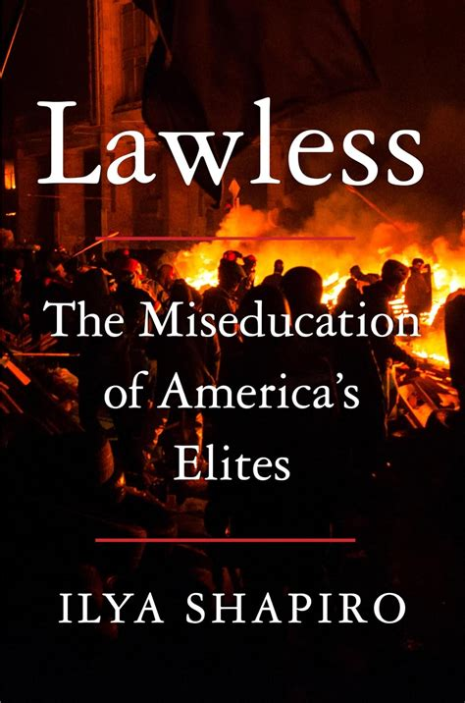
FAIR’s Mission
Promote civil rights and liberties for all Americans, and to advance a common culture based on fairness, understanding, and humanity
The suppression of dissenting views
The erosion of academic freedom and institutional neutrality
The politicization and capture of educational institutions via DEI and CRT ideologies
Published Jan. 2025

Slide 3
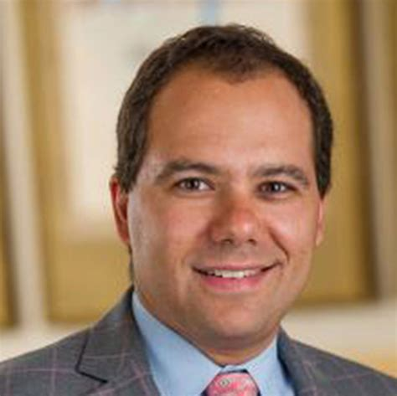
Manhattan Institute - Director of Constitutional Studies
Georgetown Law School Center for the Constitution - Executive Director (for a few months in 2022)
Books, Articles - Wall Street Journal, Harvard Journal of Law, Washington Post, LA Times, USA Today, National Review, and Newsweek.
Cato Institute - Director
George Washington University and University of Mississippi - Law professor
BA - Princeton University, MS - London School of Economics, JD - University of Chicago Law School
Filed more than 500 amicus “friend of the court” briefs in the Supreme Court.
Ilya Shapiro

Slide 4
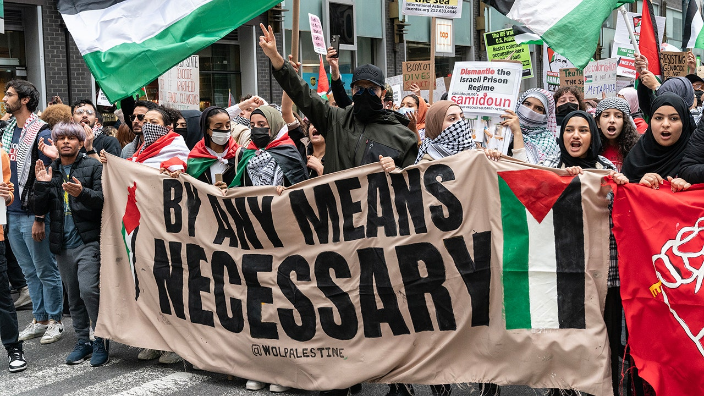
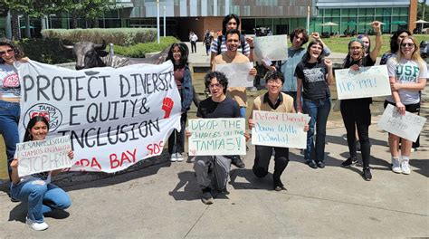
Central Thesis
Legal education is abandoning its roots
DEI bureaucracy is overtaking academic freedom
Law schools are becoming ideological echo chambers
Key Themes
Institutional Decay in Elite Law Schools
Law as a Tool for Partisan Goals
Dismantling Classical Liberal Education

Slide 5
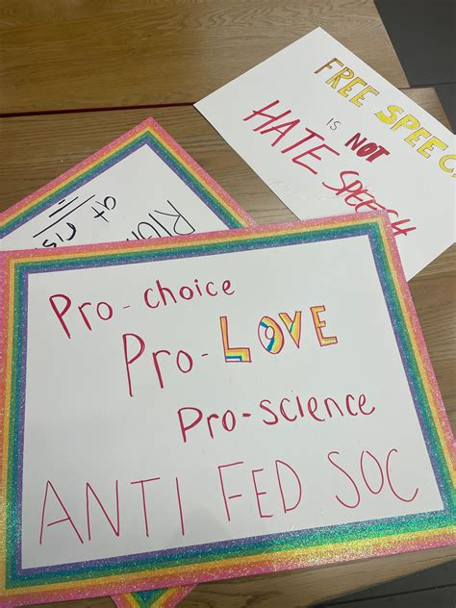
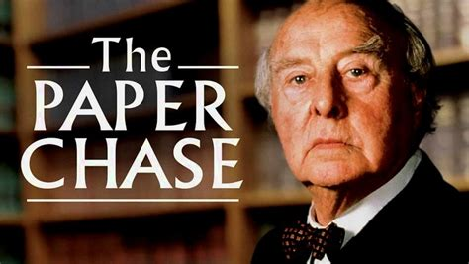
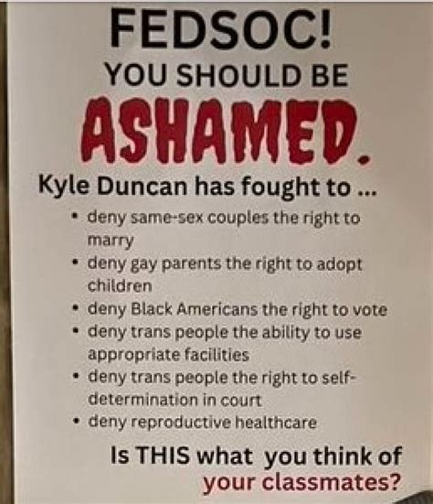
LAW SCHOOLS
NOW
THEN
1973 film – Harvard Law School
Trained students to reason, argue, listen, think critically
Advocate for rule of law, equal protection, fairness
Dismantle history & legal precedents & Question the law
Protest viewpoint diversity & freedom of speech
Support identity politics, call for trigger warnings
Notes:
Racialist approach to criminal law –
Prof at U of Buffalo suggested not teaching Dred Scott v Sandford (of African descent can’t be citizens) – insulting
Plessy vs Ferguson (Separate but Equal) - traumatized students

Slide 6
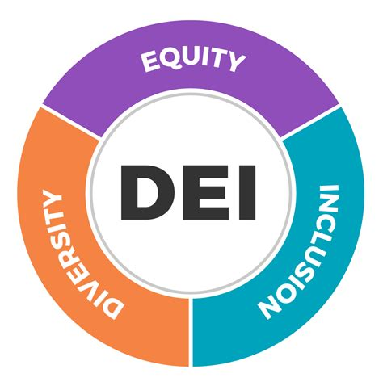
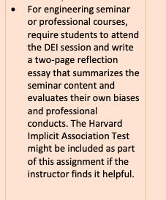
What is DEI and CRT?
The crux of the ideological movement
A by-product of Affirmative Action
Diversity: Representation across races, genders, identities
Equity:
Outcomes to correct disadvantages
Inclusion:
Welcoming of all historically marginalized persons
In Practice
Mandatory DEI training for faculty
DEI statements in hiring and admissions
Student affinity groups and tribalism based on identity politics
Trigger warnings and safe spaces
Notes:
Aff Action cases:
Allan Bakke – 1978 UC Davis reserved 16 seats for minorities despite test scores and grades. Supreme Court 4 – 4; Lewis Powell said can use race, but not quotas -- Court decided preferential treatment for minorities could reduce educational opportunities for whites without violating the Constitution.
Grutter vs U of MI – 2003 supreme court said okay to use race in admissions to advance diversity (not using quotas)
SFFA vs Harvard/UNC - 2023 – Reversed Aff Action rulings (Justices, including S Day Oconnor “they’ll soon come a day when we won’t need AA”
Faculty Hiring – diversity statements read before CVs

Slide 7
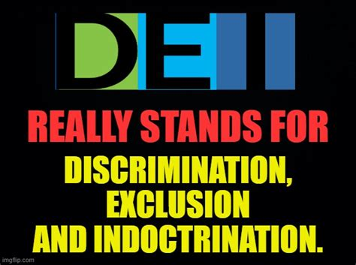
What is DEI and CRT?
The crux of the ideological movement
Imposes ideological conformity
Discourages dissent and open inquiry
Prioritizes feelings over facts
Subverts meritocracy and free speech
Creates ideological monocultures
Notes:
Encourages cancel culture (First woman to head ACLU, Nadine Strossen – assumes every word, facial gesture and tone is recorded and analyzed)
Students afraid to participate in class for fear of stepping out of what is ideologically accepted (146)

Slide 8
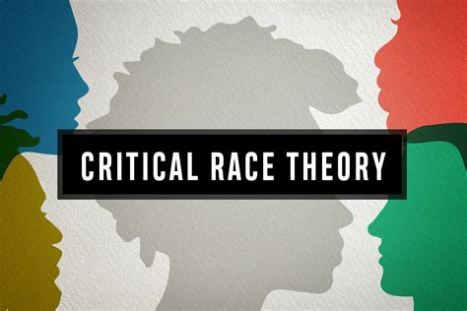
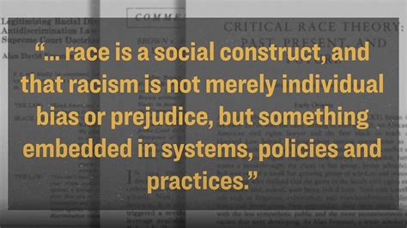
What is DEI and CRT?
The crux of the ideological movement
Legal frame viewing racism as systemic
Asserts that law upholds racial hierarchies
Origins in 70s elite law schools (Harvard, UCLA, Columbia)
In Practice
Property Law taught as “settler colonialism”
Law clinics focused on “social justice lawyering”
Race-conscious sentencing laws
Notes:
Founders – Derrick Bell, Kimberlee Crenshaw, Cheryl Harris
Canada encouraged judges to give lenient sentences to nonwhite criminals.
2020 CA Racial Justice Act (felons right to challenge convictions as racially biased)
2023 CA bill requiring judges to consider a convicted criminal’s race when determining sentencing (agents of social change not impartial adjudicators)
2021 – Council for Higher Ed Accreditation (CHEA) implemented first DEI requirement for Schools “must manifest a commitment to diversity, equity and inclusion.
NASDAQ implemented gender and race quotas for new listings.
One-sided Amicus briefs – in Dobbs and SFFA vs Harvard/UNC supreme court case, not one brief from 200 top law firms were filed on winning side.

Slide 9
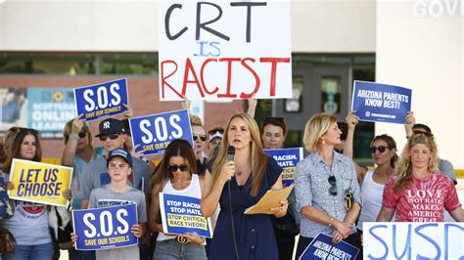

What is DEI and CRT?
The crux of the ideological movement
Undermines colorblind legal principals
Promotes activism over adjudication
Discourages viewpoint diversity
Emphasis on identity politics
“It provides the ideological mothers’ milk for activists, and trains the people who then go onto jobs in government and primary/secondary education and the ‘journalists’ who push this coverage,” -- William Jacobson, Cornell Law Prof.
Notes:
Wm Jacobson – Cancelled at Cornell Website to track DEI in schools. Criticalrace.org

Slide 10
Why it Matters
“The students who are on the news, who rage against anyone who disagrees with them, in 20 years are going to be joining the federal bench” – Shapiro
Today’s lawyers are discouraged from . . .
politically incorrect clients
republican legislators
anyone challenging climate or vaccine regulations
religious-liberty cases
anyone associated with Trump
Law students judges, politicians, legislators
Cultural training impacts future legal norms
Law weaponized as a tool for reform, revolution,
Notes:
99

Slide 11
Why it Matters
99% of law firms in 2020 implemented DEI Programs
Are Law students being trained to be activists or advocates?
One-sided Amicus briefs – Dobbs; SFFA vs Harvard/UNC (2023), not one brief from 200 top law firms were filed on winning side
2023 CA bill requiring judges to consider a convicted criminal’s race when determining sentencing
Kirkland and Ellis asked top attorney to drop conservative clients or resign
Clerkships offered only to students of color
Notes:
99% of 240 law firms that responded to survey….
What is the implication for legal objectivity?
SFFA case 6-3 against Harvard and UNC
2020 CA legislation - felons right to challenge convictions on basis of race
Pro-life law firm partner asked to do pro bono work for women wanting abortions, she said she was too busy so managing partner forced her resignation
Senior partner called a racist after making positive comments about the Dobbs ruling.
Kirkland and Ellis asked their best appellate lawyer in country to drop his conservative clients or resign.

Slide 12
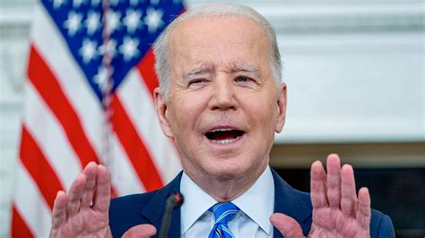
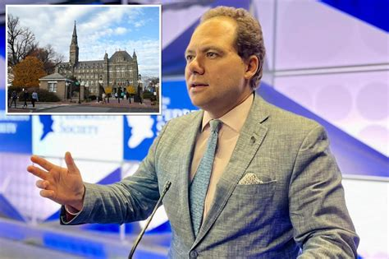
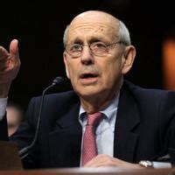
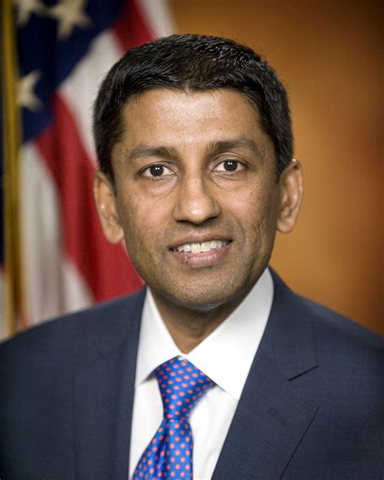
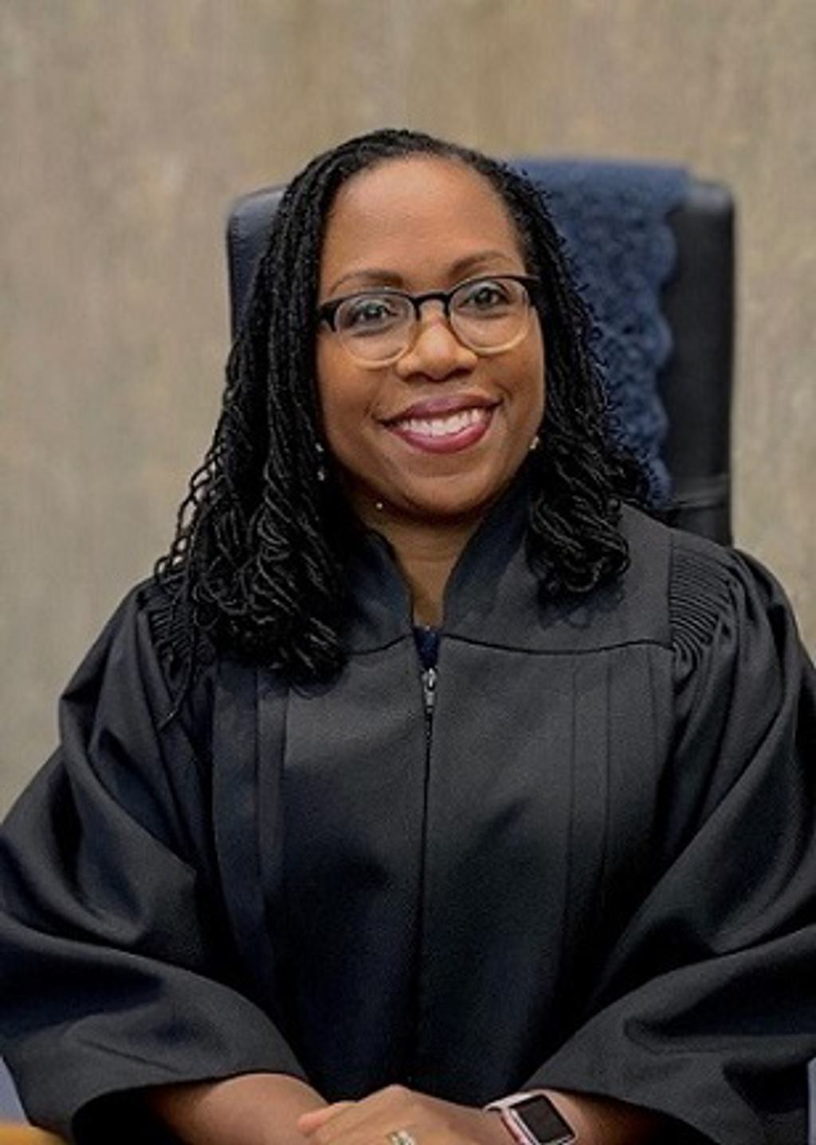
Shapiro Tweet Incident
January 26, 2022
Joe Biden
Pledges to nominate the first black woman to Supreme Court
Ilya Shapiro Director of Constitutional Studies, Georgetown
Stephen Breyer
U.S. Supreme Court from 1994 -2022
Sri Srinivasan
Circuit Judge, US Court of Appeals for DC
Ketanji Brown Jackson
Judge, U.S. Court of Appeals for the D.C. Circuit
Notes:
Jan 26 2022

Slide 13

“Objectively best pick for Biden is Sri Srinivasan. . . Even has identity politics benefit of being first Asian (Indian) American. But alas, doesn’t fit into the latest intersectionality hierarchy so we’ll get lesser black woman.” – Jan 26 2022 tweet by Shapiro
4 days in hell – firestorm, backlash on social media
4 months in purgatory – investigation GT
“I apologize. I meant no offense, but it was an inartful tweet. I have taken it down.”
Notes:
Due to start at GT on 1/31/22. 4 days of hell – facing the social media firestorm, 4 months of purgatory – facing GT DEI administrators
Technicality – comments made before he was officially employed. Ultimately – decided to quit and join MI. “
Executive director at the Georgetown Law School Center for the Constitution

Slide 14
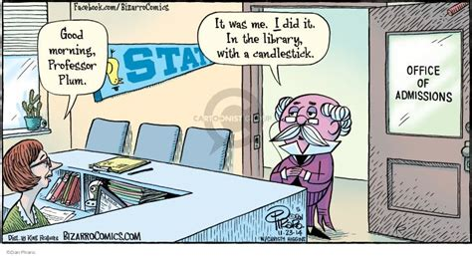
The Process is the Punishment
HR/IDEAA determined that there was ”significant negative impact on the Georgetown Community”
– prioritizing Impact on “feelings” over intent of speech
IDEAA recommended measures to prevent the recurrence of offensive conduct by Shapiro:
PR guidance with communication
Courses subject to review
Summer training program on implicit bias
Future violations subject to disciplinary action
Investigations seek truth
Inquisitions seek evidence for a predetermined result
Notes:
Biden was the only one making a racist sexist comment by saying he would only appoint a black woman.
IDEAA – institutional diversity, equity and affirmative action
Cleared on June 6 2022, resigned due to a hostile environment ;
Dean Treanor wimped out -- offered to “listen, learn and ultimately do better…I know how painful and awful it is for you, and I know what a terrible burden it is.”
Shapiro not an isolated case – over 1000 faculty sanctioned in academia over the past 2 decades with 5 in 2000 and nearly 150 in 2022.
Jeet Jeer (left wing literary critic) Shapiro's comments “were vile, but well within the parameters of academic free speech.”
Treanor wimped out offered to “listen, learn and ultimately do better…I know how painful and awful it is for you, and I know what a terrible burden it is.”
GT Professor Paul Butler – criminal law and civil rights – W.Post article “Yes, Georgetown should fire an academic for a racist tweet.”

Slide 15
The Process is the Punishment
Over 1080 sanctions in Academia in 22 years
5 in 2000 growing to 145 in 2022
Wm Jacobson (Cornell) – (founder of Legal Insurrection Website) criticized BLM
Thomas Smith (USD) – posted findings of Covid 19 from lab – persecuted by students
Amy Wax (UPenn) – said admission criteria leads to black students in lower tiers of achievement
Scott Gerber (ONU) – criticized DEI training
Notes:
38% from Admins; 16% from Undergrads,
Jacobson -- Dean Eduardo Penalver supported Jacobson’s persecutors.
Smith - Dean ruled protected speech but did nothing
Amy Wax – Lengthy Investigation found complaints baseless but Dean Theodore Ruger abandoned Academic Freedom and asked faculty senate to impose heavy sanctions: booted from 1st year classes. (last time such action against a tenured prof was because he killed his wife). 9/2024 confirmed 1 year suspension with half pay, public reprimand, no summer pay, removal of chair position. (Paul Levy, donor on board resigned in protest)
Scott Gerber – Kafkaesque investigation (wouldn’t reveal charges or complaints). Campus security followed by town police interrupted his class and escored him to dean’s office. Banished from campus.

Slide 16
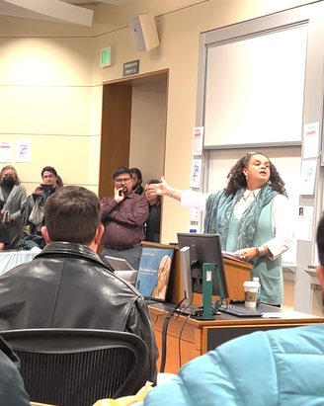
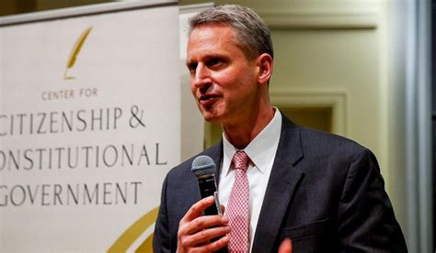
Stanford Law Incident
March 9 2023
Justice Kyle Duncan
5th Circuit Court of Appeals
Tirien Steinbach, Diversity Dean
“He represents a significant hit to their sense of belonging.”
“Speech that feels abhorrent, that feels harmful, that literally denies the humanity of people” is to have “more speech and not less.”
Called for school to discipline event disrupters and to fire Steinbach. “If enough of these kids get into the legal profession, the rule of law will descend into barbarism.” (115)
Notes:
Response to “speech that feels abhorrent, that feels harmful, that literally denies the humanity of people” is to have “more speech and not less.”
Protesters shouted “I hope your daughters get raped” During speech, hecklers shouted over Duncan
Judge Duncan doesn’t subscribe to current woke academic orthodoxy; advocates. Doxed Fed Soc members

Slide 17
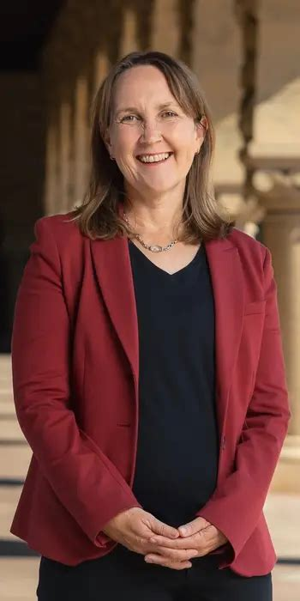
Stanford Law Incident
“Freedom of speech does not protect a right to shout down others so that they can’t be heard. . . Our commitment to Diversity, equity, and inclusion is not going to take the form of having the school administration announce institutional positions on a wide range of current news events, or exclude or condemn speakers who hold views on social and political issues with whom some or even many in our community disagree…”
Dean Jenny Martinez
Notes:
Dean Martinez writes 10 pge letter see p 119 – good letter
But no punishment “The dean of a law school doesn’t think actual rule breakers should be punished because others who merely behaved badly and uncivilly are within their rights.

Slide 18
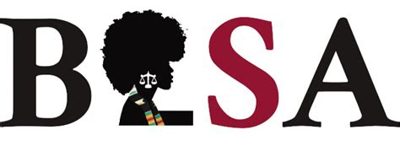
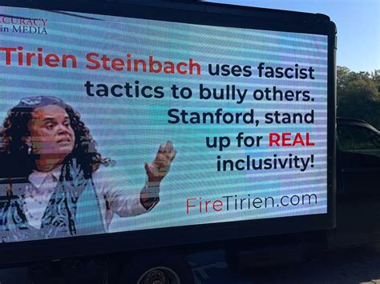
The Stanford apology “aligns with white supremacist practices, leaving members ashamed of the institution we were once excited to attend.”
Not everyone agreed

Slide 19
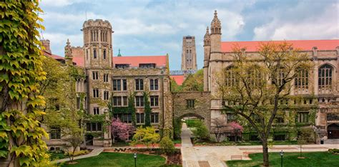
Gold Standard for Academic Freedom
and Institutional Neutrality
“The neutrality of the university… arises out of respect for free inquiry and the obligation to cherish a diversity of viewpoints”
1967, Kalven Report
University of Chicago
What Happened?
Notes:
Foundation for Georgetown, Stanford, Yale, Columbia, Harvard, UCLA – So what happened?

Slide 20
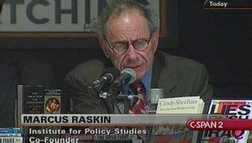
Growth of Bureaucracy
1970: 446,830 profs and 268,952 admins
1975-2005: Professors grew 50%; admins grew 85%, admin staff grew 240%
1993-2009: Admins grew at 10x growth of tenured faculty
1987-2012: Private university admin doubled Public universitiy admin grew 34x
1993-2007: Admin spending increased 61% per student. Instruction-related increased 39%
2018-2019: Schools spent less than 30% on instruction
Marcus Raskin believed the government could be overthrown by taking over the administrative state.
Notes:
2018-2019 School budget is $632 Billion with less than 30% on instruction

Slide 21
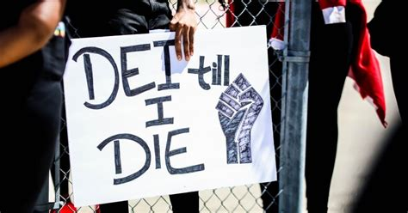
Growth of Bureaucracy
Average school has 45 admins devoted to DEI – 2021 survey of 65 large universities
261 staffers focused on DEI at U of Michigan in 2023, at $30 million/year
Council for Higher Ed Accreditation (CHEA) implemented DEI requirement for all schools in 2021: “must manifest a commitment to diversity, equity and inclusion”
“ Universities no longer see their role as facilitating open search for truth, or … producing skilled lawyers … they employ an army of educrats who … prevent truth-seeking by enforcing an ideological orthodoxy” (67-68)

Slide 22
Policies Requiring DEI
Biden’s EO #13985 – Advancing Racial Equity (1/20/2021)
“Each unit of govt must evaluate whether and to what extent its programs and policies perpetuate systemic barriers to opportunities and benefits for people of color and other underserved groups.”
Biden’s EO #14035 – Diversity, Equity and Inclusion in the Federal Workplace (6/25/2021)
Establishes DEI as a priority and tasks high govt officials with establishing government-wide DEI strategic plan
Biden’s EO #14091 -- Further Advancing Racial Equity (2/16/23)
“… embed equity into all aspects of federal decision-making… requires office of Management and Budget to Support equitable decision-making, promote equitable deployment of financial and technical assistance, and assist agencies in advancing equities” (23)
Notes:
11 pseudo-scholarly articles. No books. Political Science Professor

Slide 23
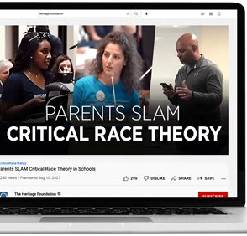
Policies Requiring DEI
American Bar Association – Accrediting body with political stances; pressures law schools to lower standards
Accrediting bodies mandate DEI compliance and impose ideological conformity
Council for Higher Ed Accreditation (CHEA) – 2021 DEI requirement: “Must manifest a commitment to diversity, equity and inclusion”
Counseling Accreditation and University course work mandates DEI and CRT compliance
CRT filtering into K-12 curriculum (CA Ethnic Studies hotly debated)
Notes:
ABA Policy statements on climate change, abortion, gun control
Request by top law schools to eliminate LSAT and grade admission requirements for 25% of entering class
George Mason pressured to lower standards until it admitted what ABA wanted – 45% of those failed (vs 4% for those accepted on merit)
Charleston School of Law had accreditation pulled due to racial quotas.

Slide 24
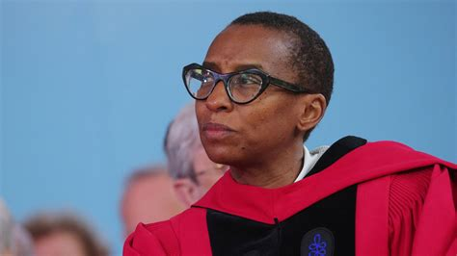
Failures of The Bureaucratic ideology
“… the apotheosis of anti-intellectual movement that values DEI, identity, and activism over truth-seeking, merit, and education” (60)
Claudine Gay - Harvard’s 2nd woman and 1st black president resigned after 6 months following her handling of antisemitism
Not all faculty support the DEI movement on campuses
2,000 responses to a survey revealed most faculty members “agreed that diversity statements put pressure on faculty to express specific positions on moral, political or social issues.”
Notes:
11 pseudo-scholarly articles. No books. Political Science Professor
“The idea that the lawyers’ duty to confront injustice must supersede all else has eroded the norm that every American deserves legal representation and that the law should treat everyone equally

Slide 25
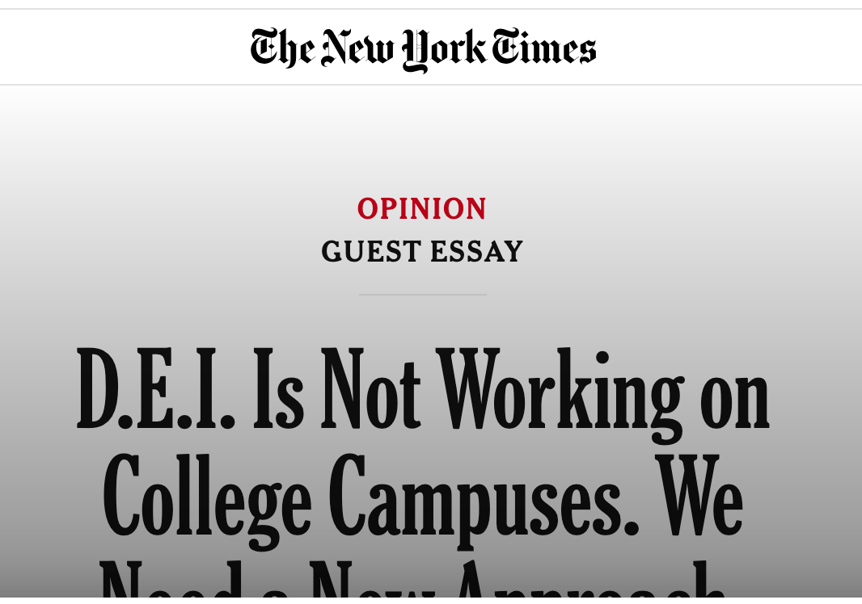
These programs “exacerbate the very problems they intend to solve and are incompatible with higher education’s longstanding mission of cultivating critical thinking,”
Best and Levine argue DEI programs place too much emphasis on identity. . .
In a DEI training program at Stanford a few years ago, Jewish staff members were assigned to a “whiteness accountability” group, and some later complained that they were shot down when they tried to raise concerns about antisemitism.
The former DEI director at a Bay Area community college described DEI as based on the premises “that the world is divided into two groups of people: the oppressors and the oppressed.” She was also told by colleagues and campus leaders that “Jews are ‘white oppressors’,” and her task was to “decenter whiteness.”
Aug 30 2024
Paul Brest, professor emeritus at Stanford Law School, and Emily Levine, associate professor at Stanford
Notes:
Not everyone agrees with the DEI movement on campuses
2,000 responses to a survey, which revealed most faculty members “agreed that diversity statements put pressure on faculty to express specific positions on moral, political or social issues.”
William Jacobson – Cornell – CriticalRace.org website to track DEI in schools

Slide 26
Ideological Homogeneity
“Real danger in hiring so many staff who don’t engage in teaching or research isn’t the expense but how it corrupts the core mission of higher education.” --Jay Greene (Heritage Foundation)
2018 Data – Higher Ed lacks diversity of thought
42% of students centrist and 20% on right
13% of professors on right (6:1 ratio)
5% administrators on right (12:1 ratio)
What does this mean for viewpoint diversity?
Self-censoring?
Pressure to conform?
Notes:
Viewpoint Diversity in Decline
“The idea that the lawyers’ duty to confront injustice must supersede all else has eroded the norm that every American deserves legal representation and that the law should treat everyone equally”

Slide 27
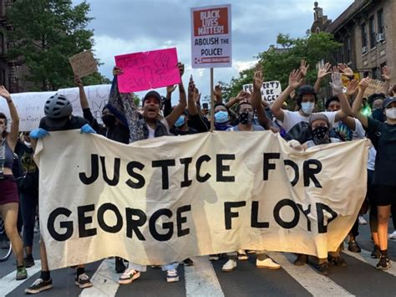
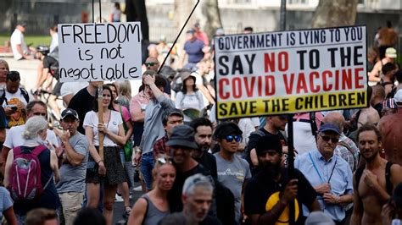
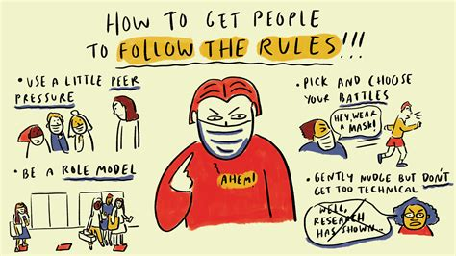
Covid and Floyd
Campus protests selectively supported
Masking, vaccine, BLM statements mandatory
Virtue Signaling as academic and social currency
Compelled Speech, conformity is moral expectation
Required to conform and obey authority
Canceling, firings, re-education training, public apologies
Chilling of research and discussion

Slide 28
Slippery Slope
From Academic Freedom and Institutional Neutrality to . . .
NYU blamed Oct 7th on Jewish State
Northwestern Pritzker School of law training for admins to denounce their own alleged racism (“I’m Jim Speta, and I am a racist.”)
Howard, Duke, Columbia, Penn, Cornell – created clinics on “social justice lawyering”
Emory Law revising mission to show “commitment to antiracism”, against The Emory Free Speech Forum, claiming ”open inquiry is harmful” – FAIR sent letter re: Title VI
Study to measure “whiteness” in Law School (Case Western)
Berkeley – Nine student groups amended bylaws to never invite speakers who support Israel
City U of NY Law School faculty unanimously backed student resolution to “proudly and unapologetically endorse the Palestinian-led call for BDS( Boycott, Divestment, and Sanctions) against Israel.” ALSO called for cancellation of projects that promote normalization of Israel.
Notes:
Case law is de-emphasized
William Spruance GT – mask slipped, held in non-compliant. Asked questions, suspended, told to submit to psych testing and waive medical rights
Trap House – Yale – party – Accused Fed Soc president of being cis/het/ white and required to read a pre-written apology by the dean of diversity. He refused. “Said an association with center right is grounds for investigation”
Called for Cancellation of events or projects that involve “Israel academic institutions” or promote normalization of Israel.(2022)
Berkely (2022)

Slide 29
Reforms and Recommendations
Abolish DEI bureaucracies
End mandatory diversity training; Hiring and admission practices
Stop political coercion (pronouns, land acknowledgements)
Eliminate identity-based preferences
Revise accreditation standards and enable alternative accreditation agencies
Promote rankings of speech freedoms and neutrality
Restore the core mission of law schools
Encourage viewpoint diversity (stop infantilizing students; they’re not fragile, emotionally distraught children)
Foster civil dialogue over safe spaces (don’t shield students from ideas)
Notes:
Encourage students to be courageous and not so easily offended

Slide 30

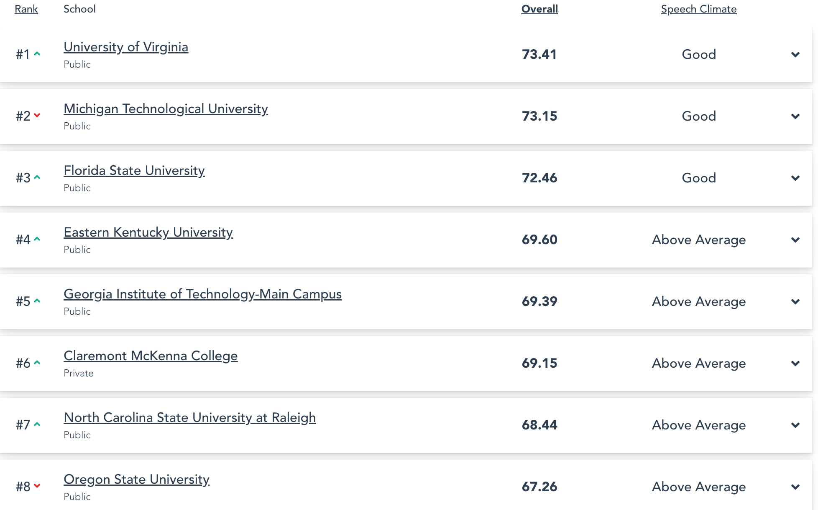
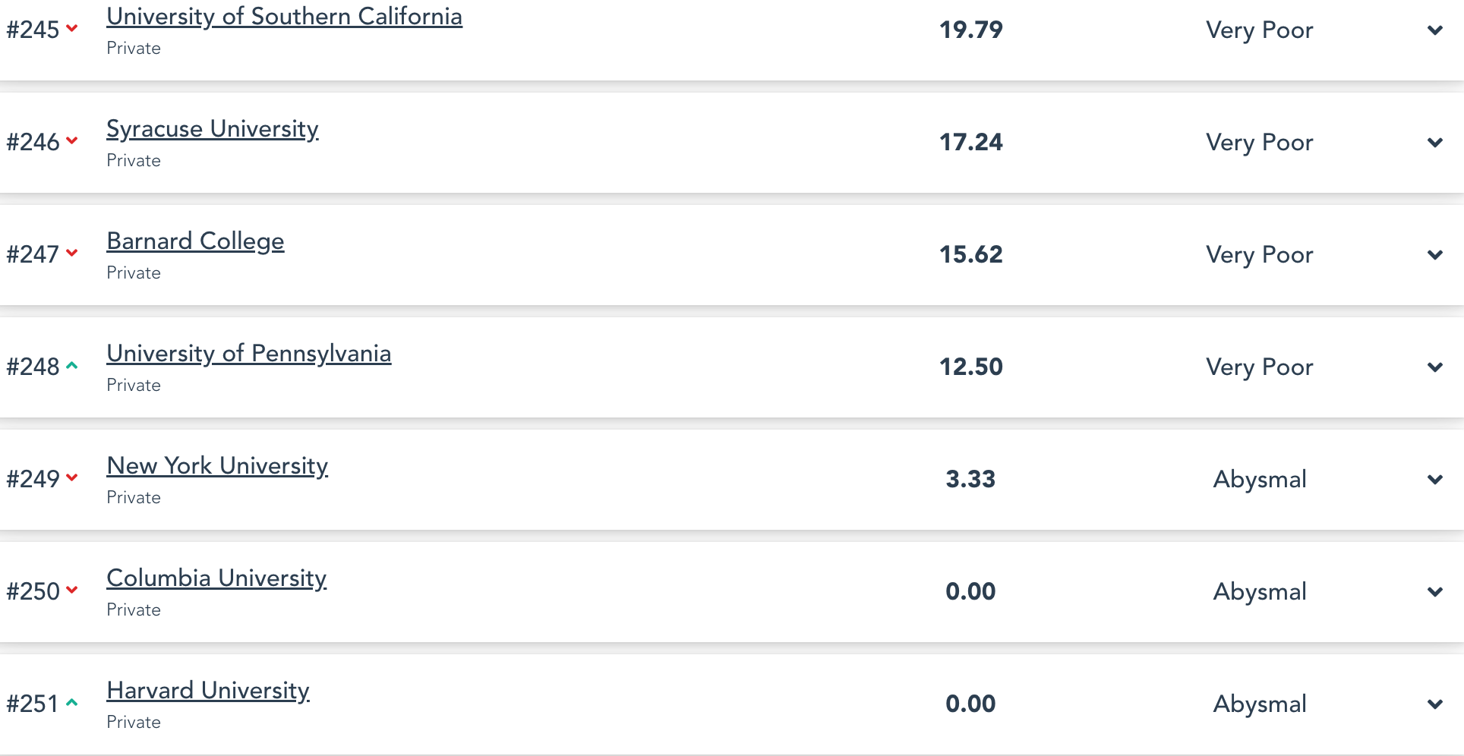
Watchdog Organizations
FIRE’s Free Speech Ratings
https://rankings.thefire.org/rank
Notes:
Shapiro provides info from the 2023 rankings.
FIRE – Alan Charles Kors (U Penn history professor) and Harvey Silvergate (defense attorney and board of ACLU) created FIRE in 1999.
2025 rankings. https://rankings.thefire.org/rank

Slide 31
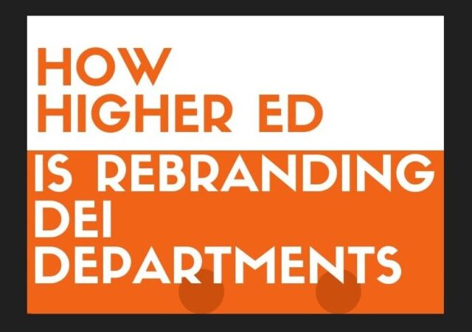
Watchdog Organizations
Tracks DEI and CRT
Following the Supreme Court decision in 2023 to reverse affirmative action in college admissions, DEI didn’t end. “It isn’t going away, it’s just going underground” – CriticalRace.org
CriticalRace.org
“Banning something doesn’t mean it will be eradicated”
“Office of Access and Engagement”
“Division of Access, Opportunity, and Diversity”
**University of Alabama, Florida State, University of Iowa, University of Northern Iowa, Oklahoma State, South Dakota State, University of South Dakota, University of Tennessee (System-wide), University of Utah, and Utah Valley University.
Notes:
Cornell Law School professor William Jacobson created the website Criticalrace.org.
Kemberlee Kaye, Managing Editor of CriticalRace.org (started in 2021): DEI would not disappear on college campuses but would move underground in a variety of ways.
https://legalinsurrection.com/2024/09/how-higher-ed-is-rebranding-dei-departments-our-study-on-how-schools-are-evading-dei-cutbacks/

Slide 32
Watchdog Organizations
Fair For All
Creating non-CRT based Ethnics Studies and Civics curriculum for K-12 along with white papers critiquing harmful Ethnic Studies courses
Monitoring accreditation rules and policies
Providing platforms for cancelled artists and academics
Filing OCR complaints
Legal advocacy for faculty, students, others harmed by DEI and CRT practices

Slide 33
Can DEI co-exist with academic freedom and institutional neutrality, and should there be any boundaries to academic freedom? If so, who sets them—and how can that authority be restrained? If there are no limits to academic freedom, how can an institution protect itself and its students from indoctrination?
What are the moral and civic responsibilities of educators with regard to ideology? Are there cases where leaders in academia ought take a stand and a position?
How can individuals resist institutional pressure to conform without becoming marginalized, cancelled, or ineffective?
How can FAIR respond in accordance with its mission to promote pro-human values, advocate for individual civil rights and liberties, and promote compassionate opposition to racism and intolerance?
What do you think?

Slide 34

Thank you
for participating and sharing your ideas
Next Book – June 25th 7:00 PM ET
NY Times best-selling author and celebrated liberal journalist, Naomi Wolf, chronicles the censorship, surveillance, lies, and violations of individual Constitutional rights that took hold during the Covid era and chronicles her personal transformation
Karen.Howes@fairforall.org
Arnold.Huntley@fairforall.org
https://www.fairforall.org/
Notes:
If you have book suggestions or questions about how to host a FAIR book club for your friends or community, contact Arnold or Karen

